Slide 1
Configure AWS for Front End

Slide 2
Set Up AWS for Angular Apps

Slide 3
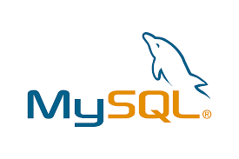
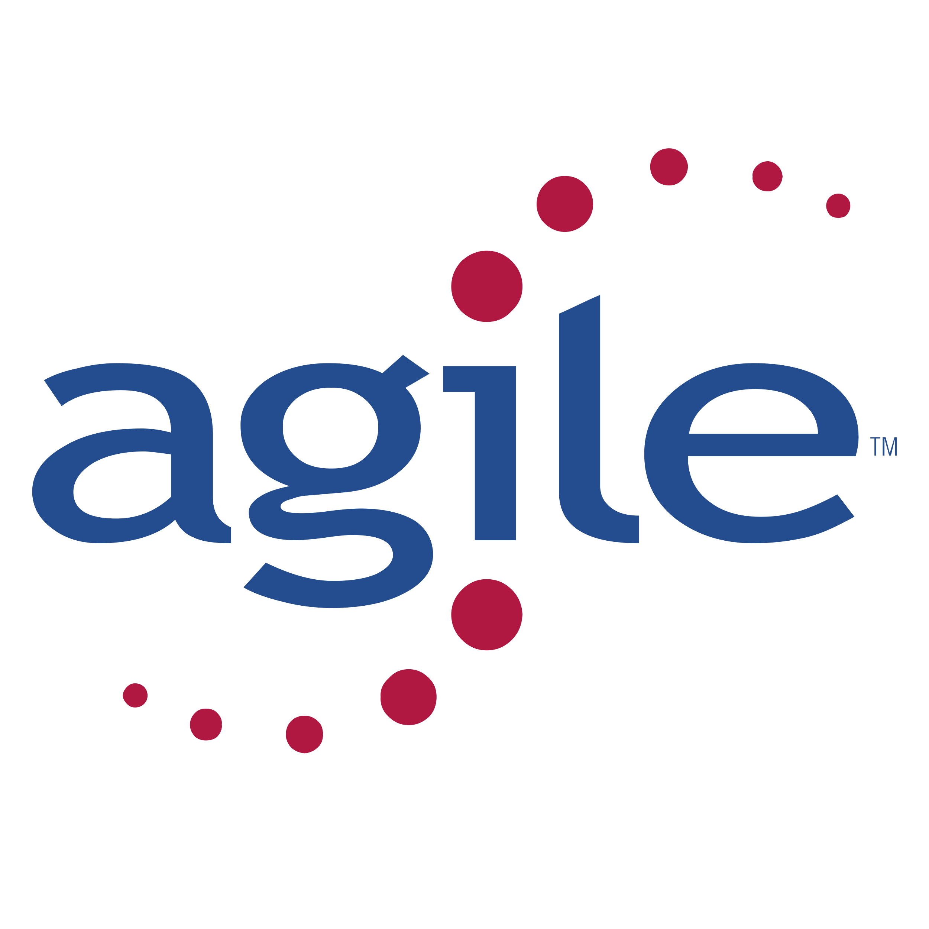
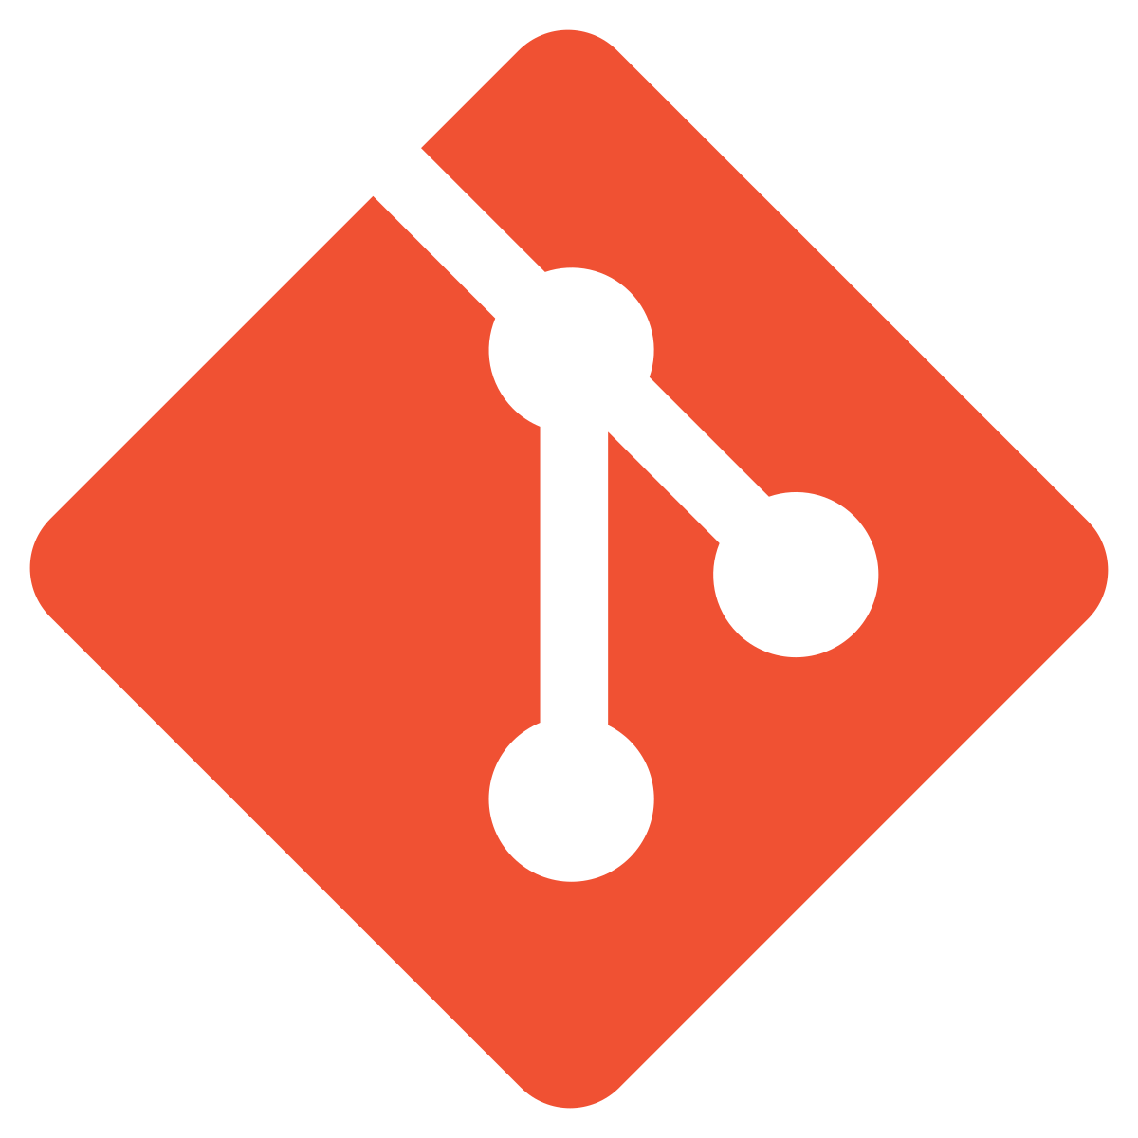
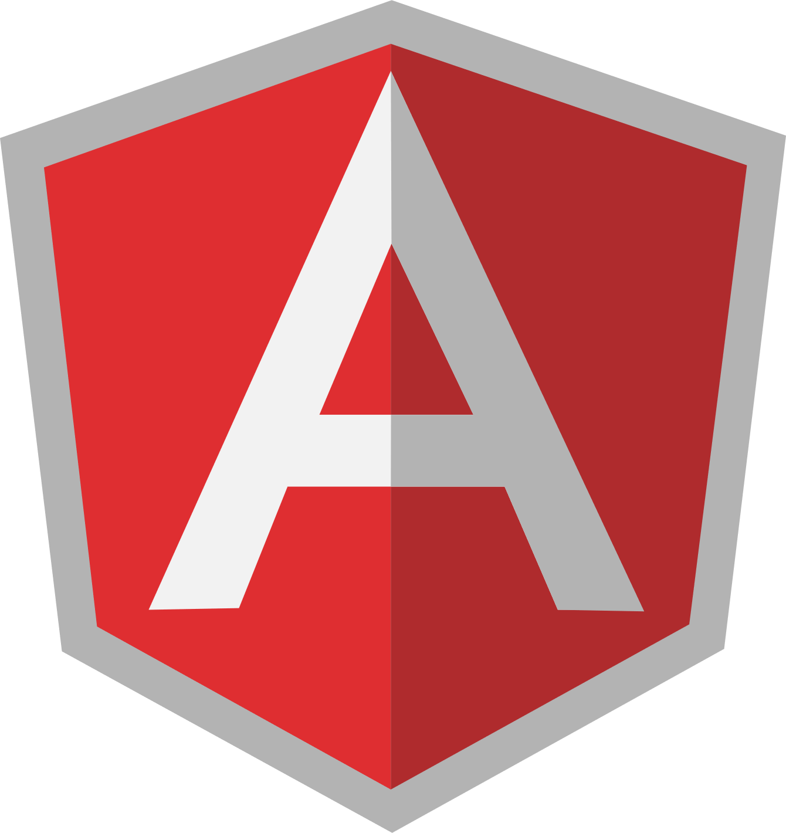
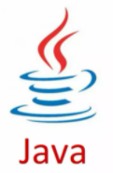
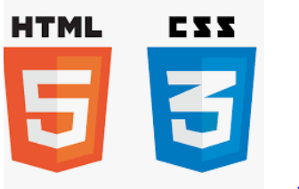
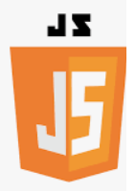
Before we begin, let’s recall what we have covered till now:
Agile
Git
SQL
Angular
HTML
CSS
JavaScript
Core Java

Slide 4
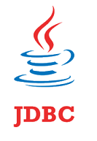

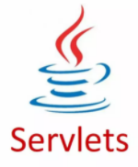

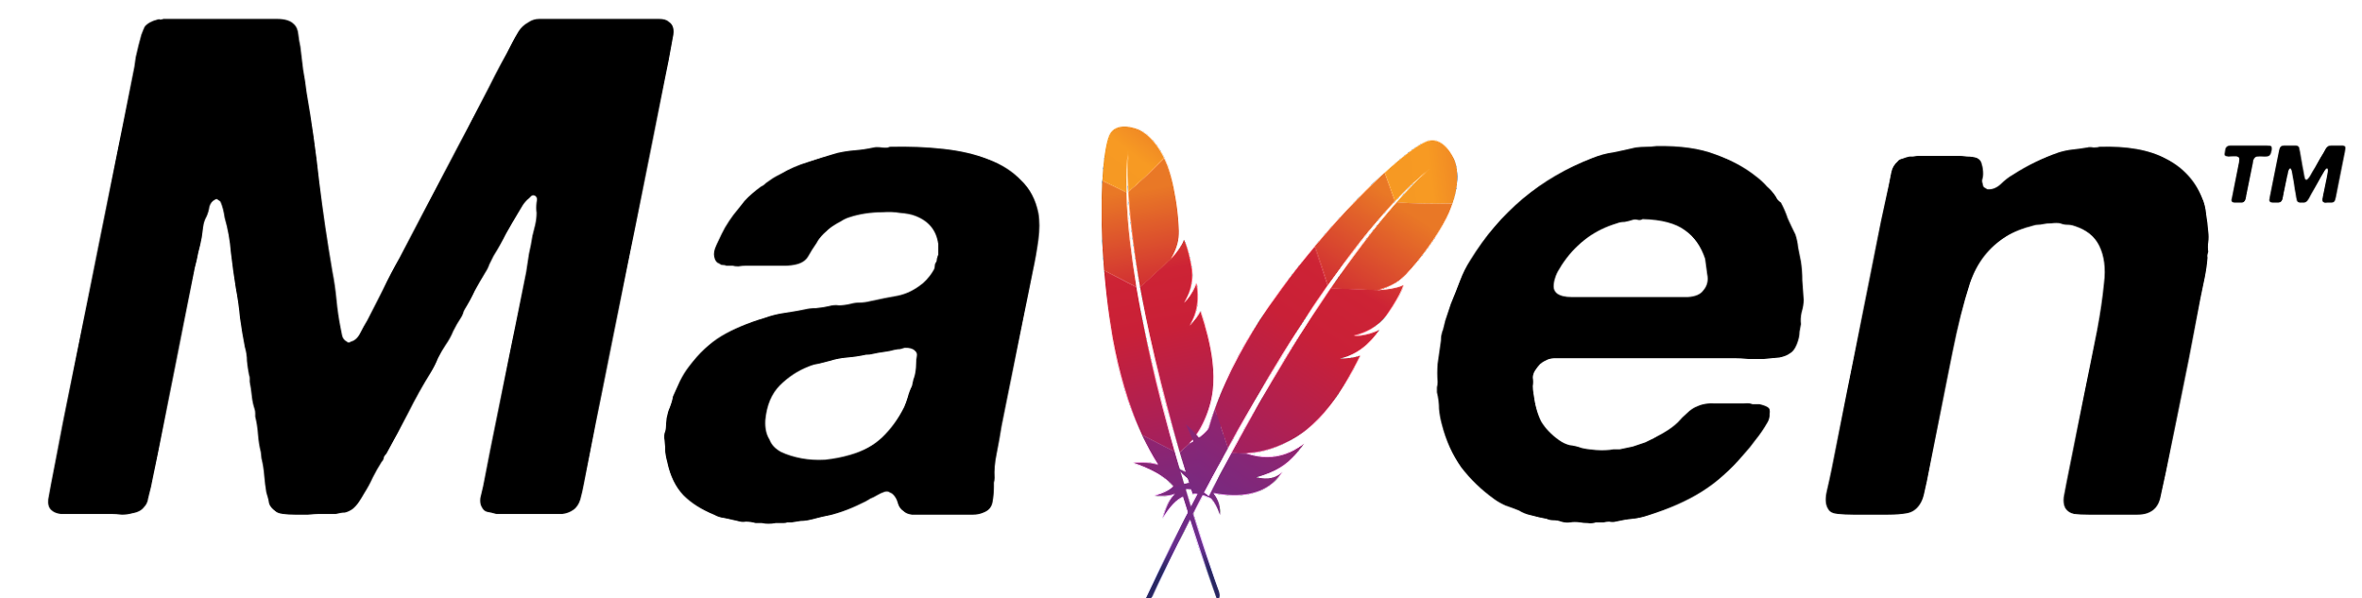
Before we begin, let’s recall what we have covered till now:
JDBC
JSP
Servlets
MongoDB
Maven

Slide 5

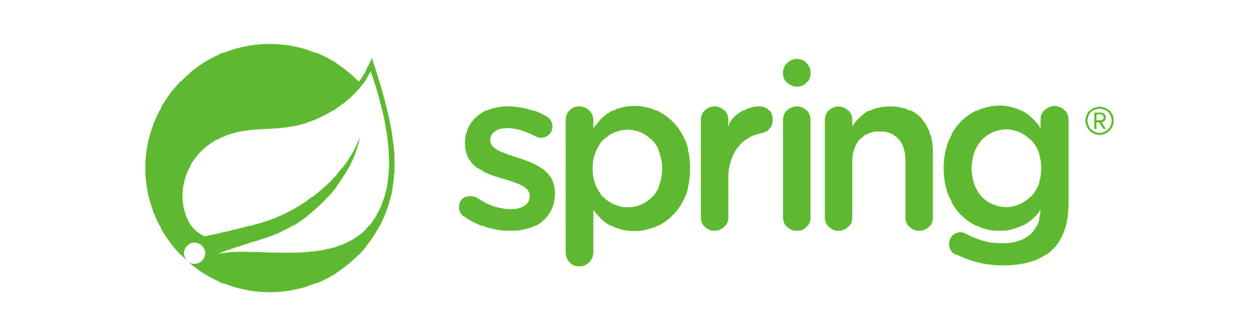
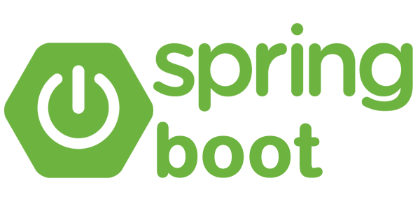
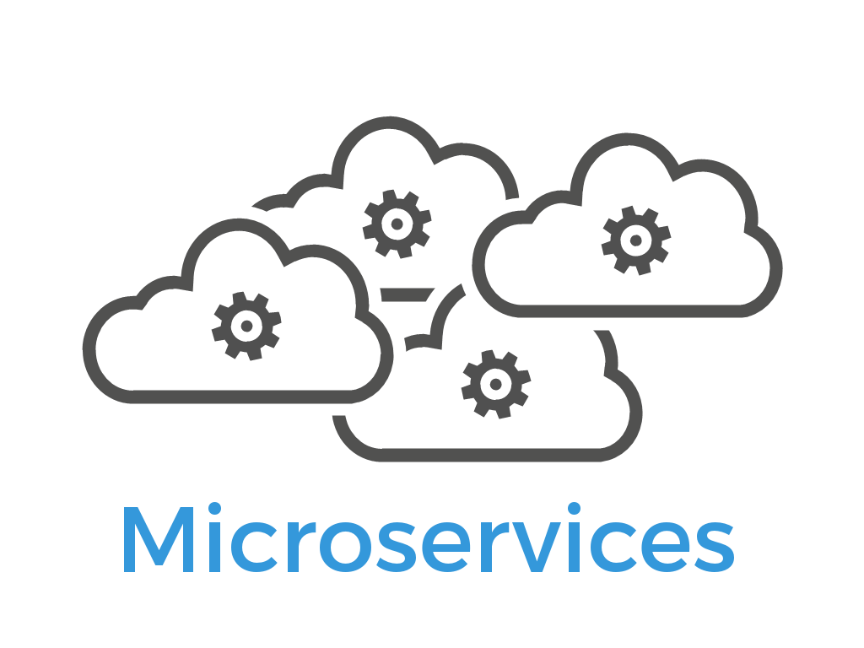
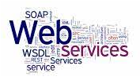
Before we begin, let’s recall what we have covered till now:
JUnit
Spring
Spring Boot
Webservices
Microservices

Slide 6
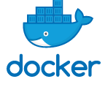
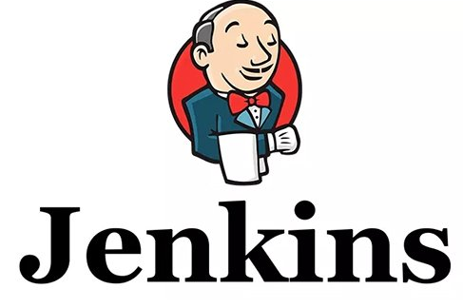
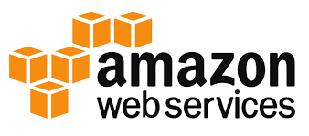
Before we begin, let’s recall what we have covered till now:
Docker
Jenkins
AWS

Slide 7
Front-End Back-End Communication
Used HTTP Client in Angular to communicate with Java back end
Implemented communication for both admin and end-user projects
Jenkins Pipeline
Used Jenkins build automation server to build angular apps and Java back end
Created Pipeline with multiple stages
Docker
Used Docker to build images for Angular apps and Java back end
Used Jenkins to dockerize the Angular apps and Java back end with Jenkins

Slide 8
As a full stack web developer, our key role is to develop both client and server software.
Angular and Node can be used to build front end of the web page.
Spring Boot, Java, and MySQL or MongoDB can be used to build at the back end.

Slide 9

Bob needs to configure AWS for front end. He brainstorms a bit and finds a solution.
Let me use Jenkins, Docker, and AWS to build CI/CD Pipelines, containerize the apps, and finally host them to AWS EC2 instance.
In this lesson, we will host the angular apps on EC2 instance, use Jenkins and Docker
as DevOps tools, and help Bob complete his task effectively and quickly.

Slide 10

Create and configure EC2 instance on AWS
Create S3 bucket
Use Jenkins on EC2 for CI/CD
Integrate Docker in Jenkins to build and release
images as containers on EC2

Slide 11
Create and Configure EC2 in AWS

Slide 12
AWS
Amazon Web Services (AWS) is a cloud platform, which offers more than 200 fully featured services.
Angular web apps on EC2 instance is deployed using Jenkins and Docker.
.
Notes:
Amazon Web Services (AWS) is a cloud platform, which offers more than 200 fully featured services.
We are now in the last phase of our project, where we will deploy the apps on AWS
We will start by deploying Angular web apps on EC2 instance using Jenkins and Docker.

Slide 13
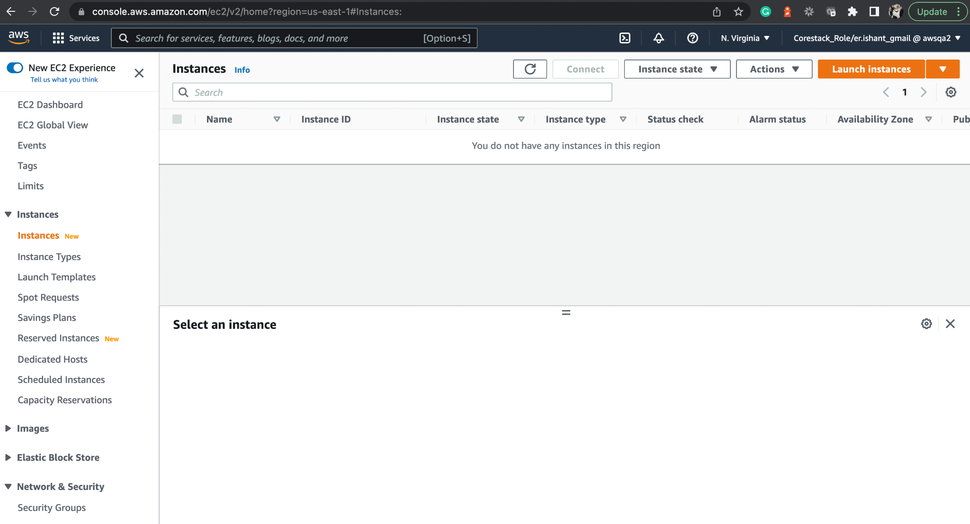
Create an EC2 Instance
Open the EC2 dashboard.
Notes:
Open the EC2 dashboard.

Slide 14
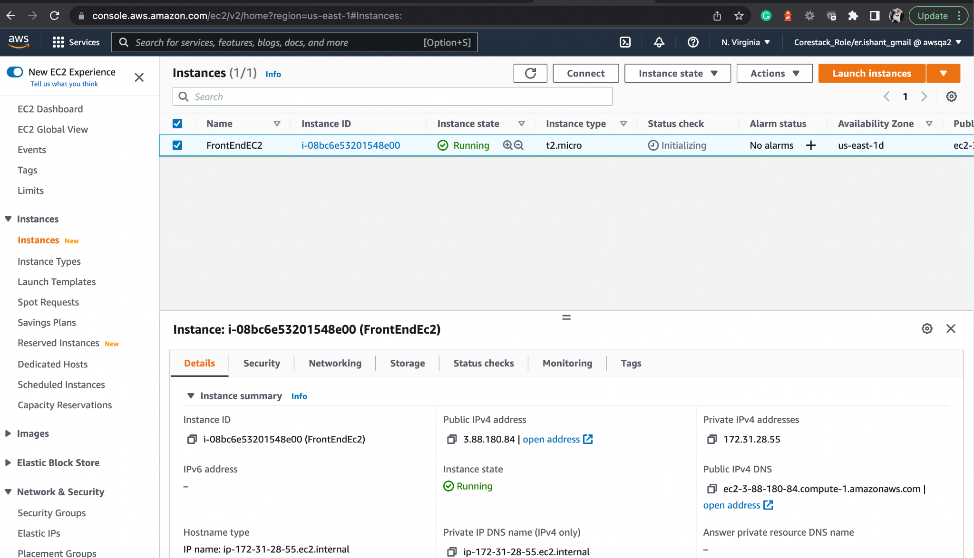
Launch Instance
Launch a new Instance.
Create service group and key pair to access the instance from terminal.
Use the AWS Cloud Shell to perform tasks.
Notes:
Launch a new Instance.
As a prerequisite, you must create your service group and key pair to access the instance from your terminal.
For this lab, we will use the AWS Cloud Shell itself to perform the tasks.

Slide 15
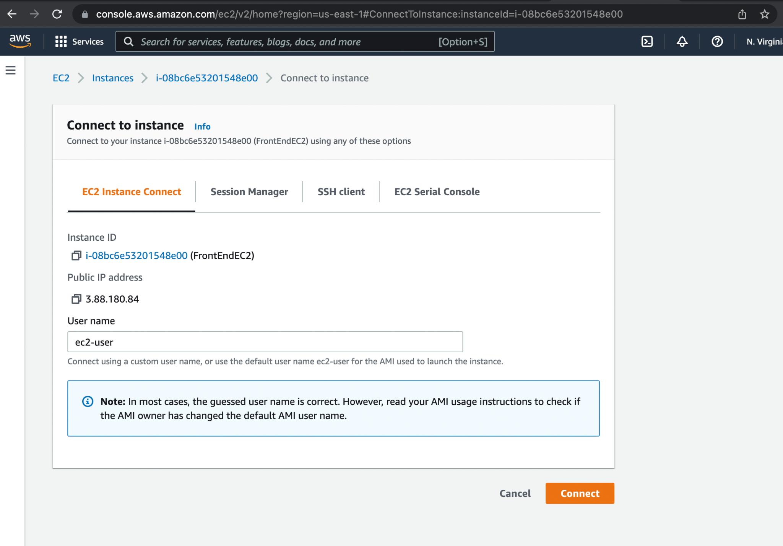
Connect to EC2 Instance
Connect through AWS Cloud Shell, which is the first option
on clicking connect that is EC2 Instance Connect.
Connect using one of the methods, like ssh.
Notes:
You can connect using one of the various methods, like ssh.
But here, we will connect through AWS Cloud Shell itself which is the first option when you click on connect i.e. EC2 Instance Connect

Slide 16
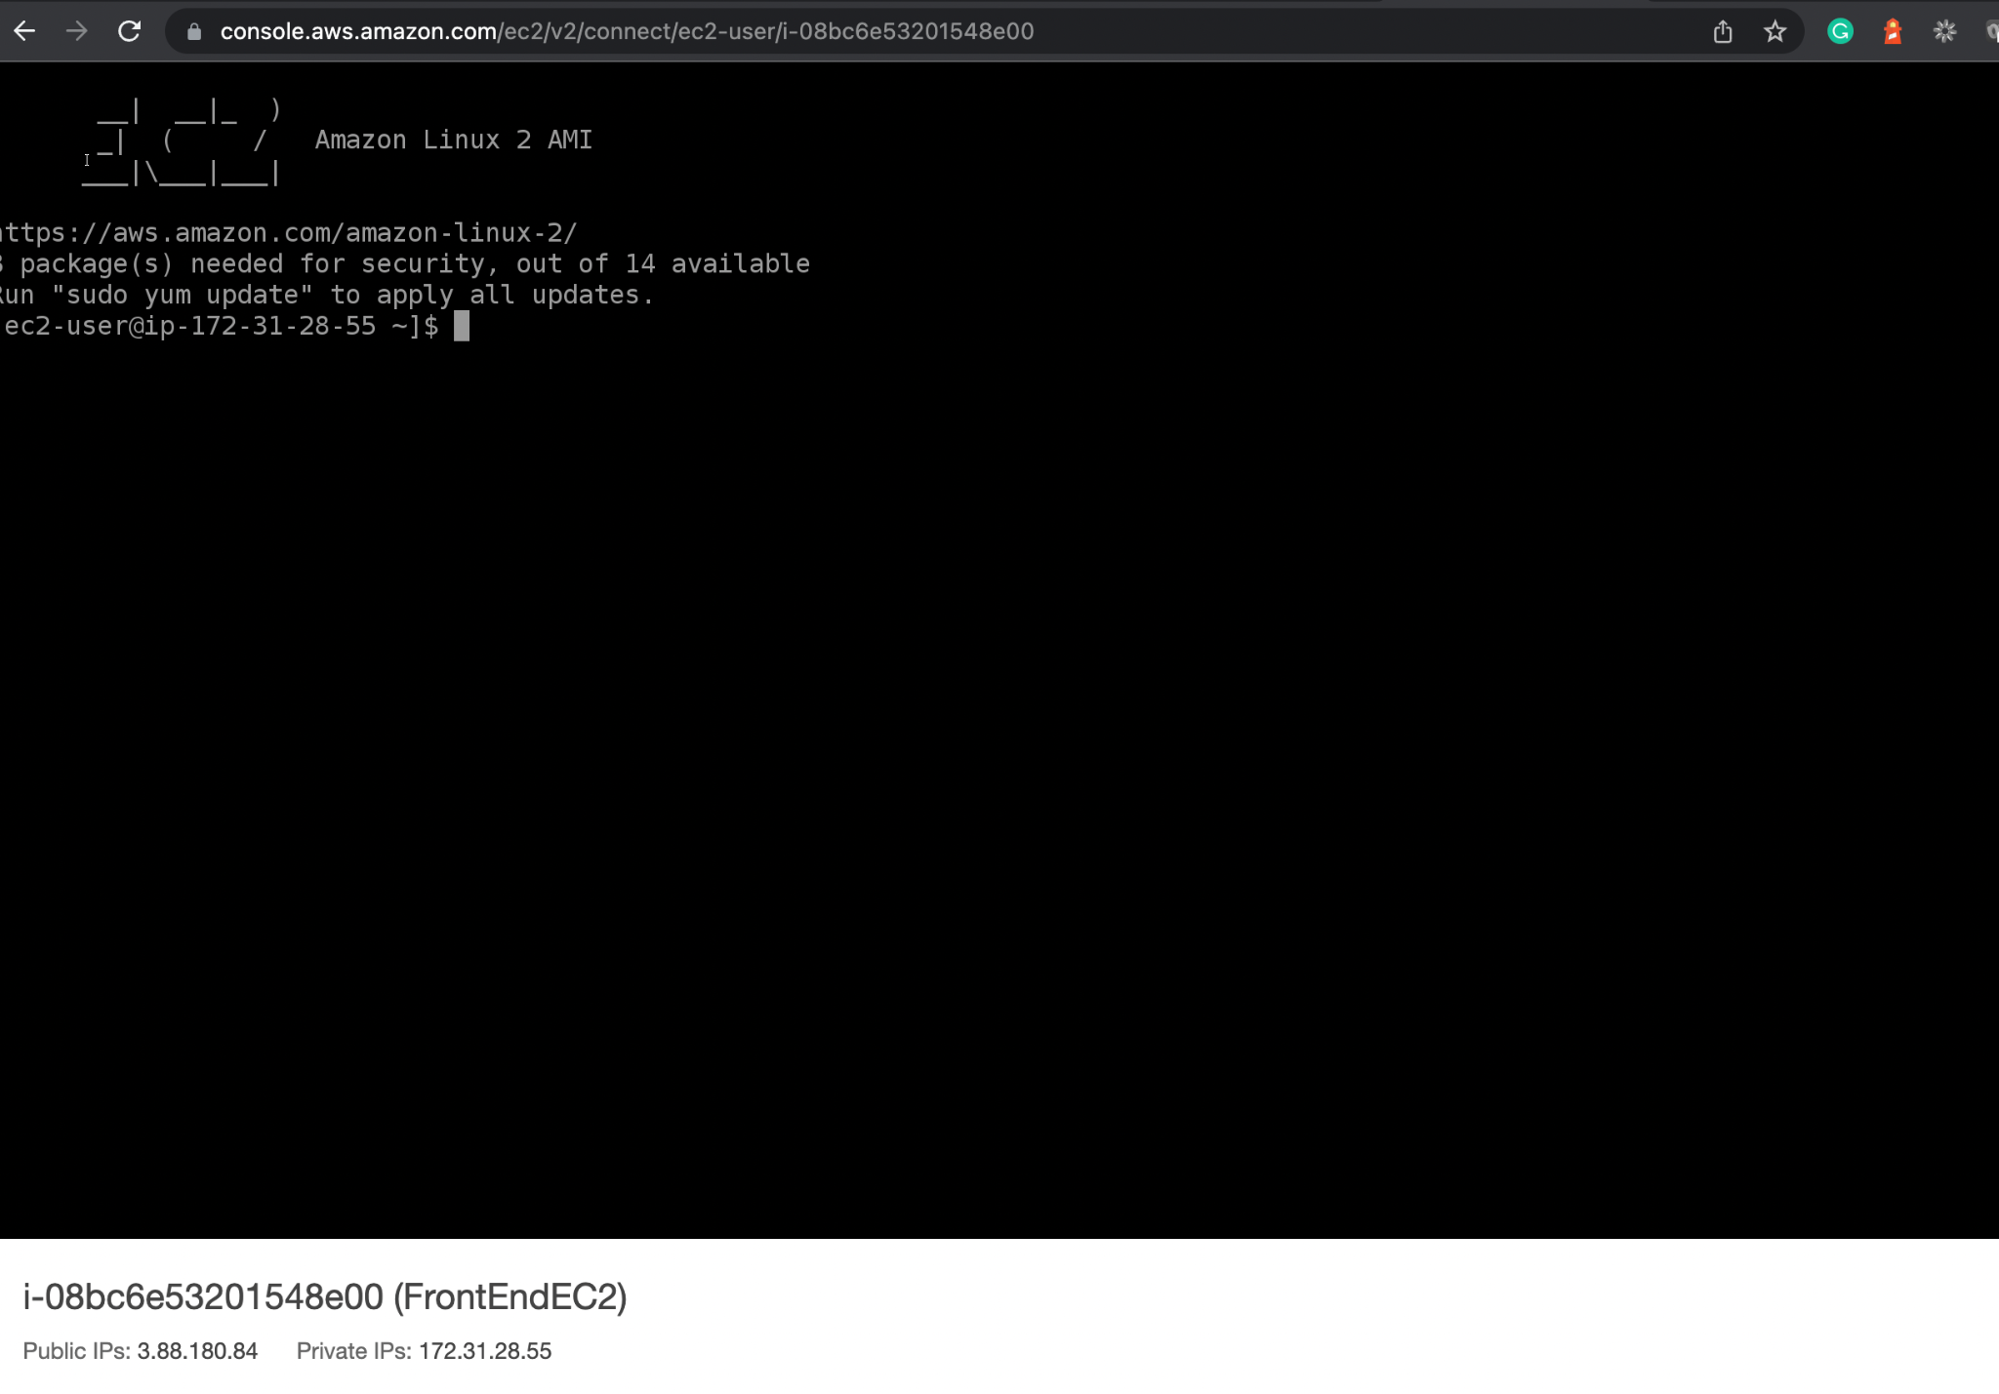
Launch the EC2 Shell and Configure the Tools
Install the tools and software required to deploy Angular apps
and configure Node, Git, Docker, and Jenkins.
Notes:
Now, let’s install the tools and software required to deploy our Angular Apps.
We will configure Node, Git, Docker and Jenkins now.

Slide 17
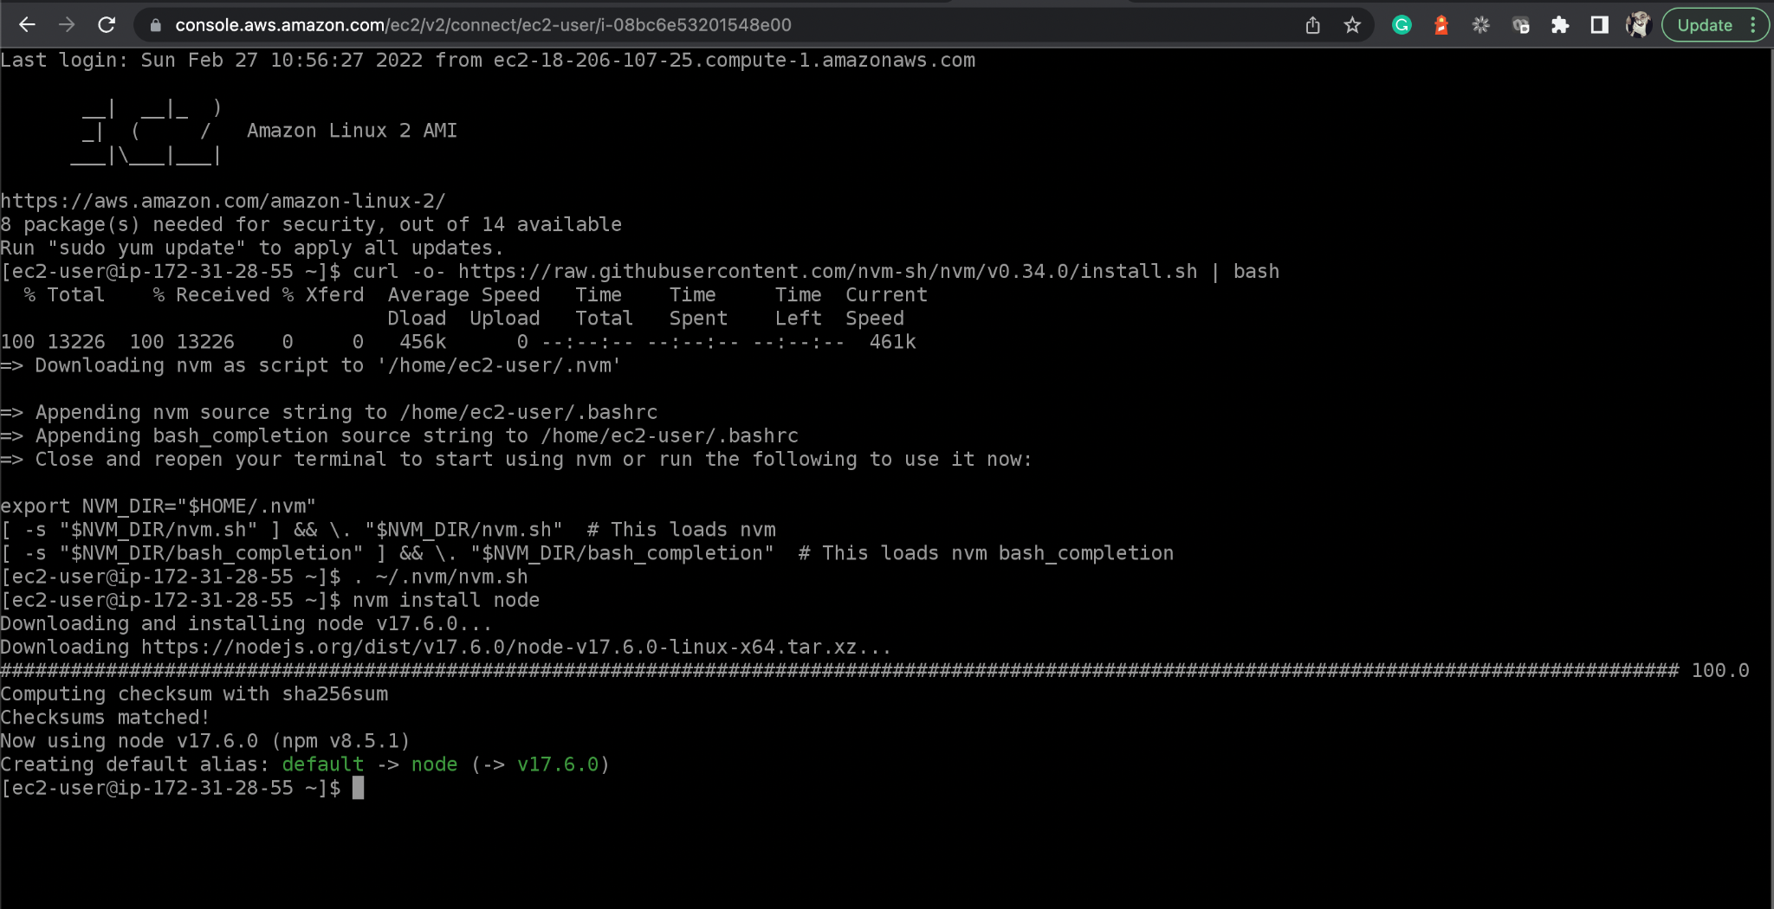
Configure Node on EC2
Configure the Jenkins Pipeline Project by passing GitHub repository URL.
Reference link on AWS Documentation: https://docs.aws.amazon.com/sdk-for-javascript/v2/developer-guide/setting-up-node-on-ec2-instance.html
Notes:
Configure the Jenkins Pipeline Project by passing GitHub Repository URL
Reference Link on AWS Documentation: https://docs.aws.amazon.com/sdk-for-javascript/v2/developer-guide/setting-up-node-on-ec2-instance.html

Slide 18
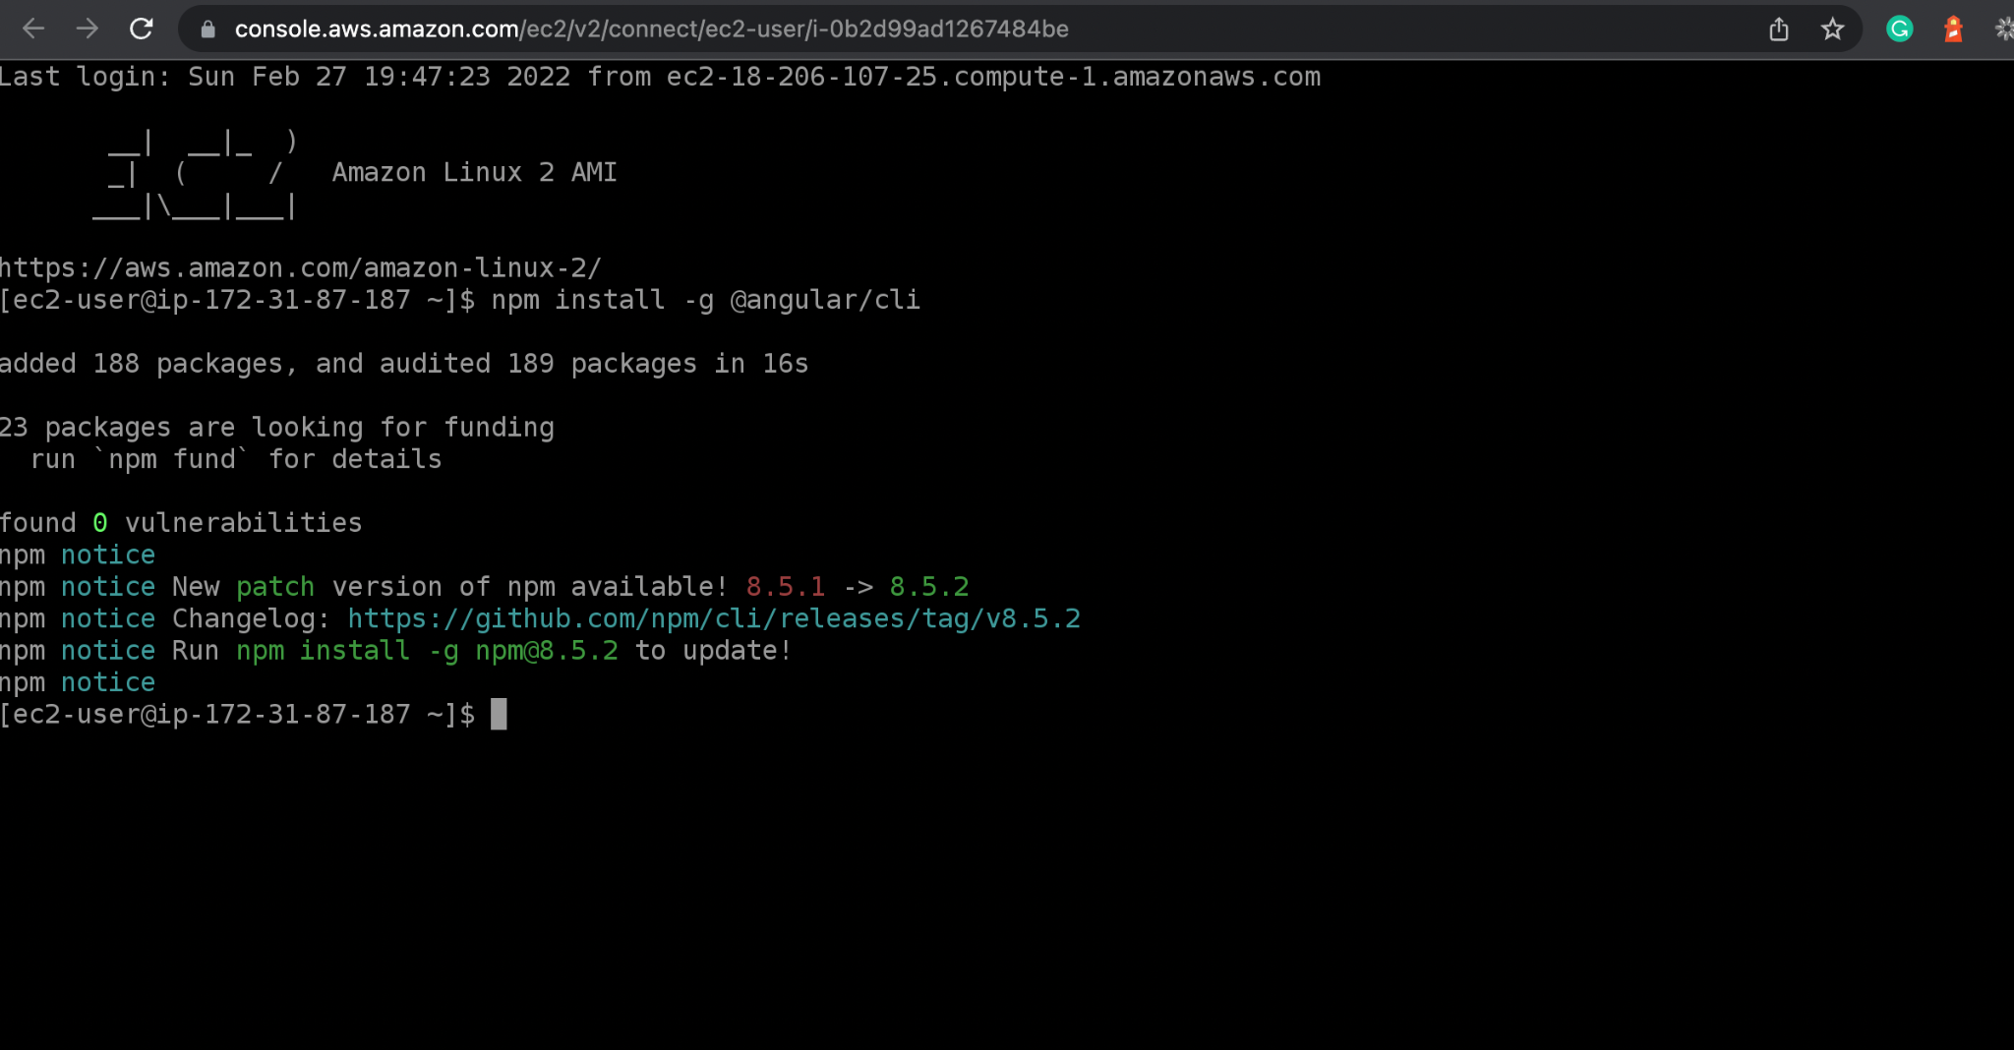
Configure Angular CLI on EC2
Add Angular CLI to run the Angular project.
Notes:
Now add Angular CLI to run the Angular project.

Slide 19
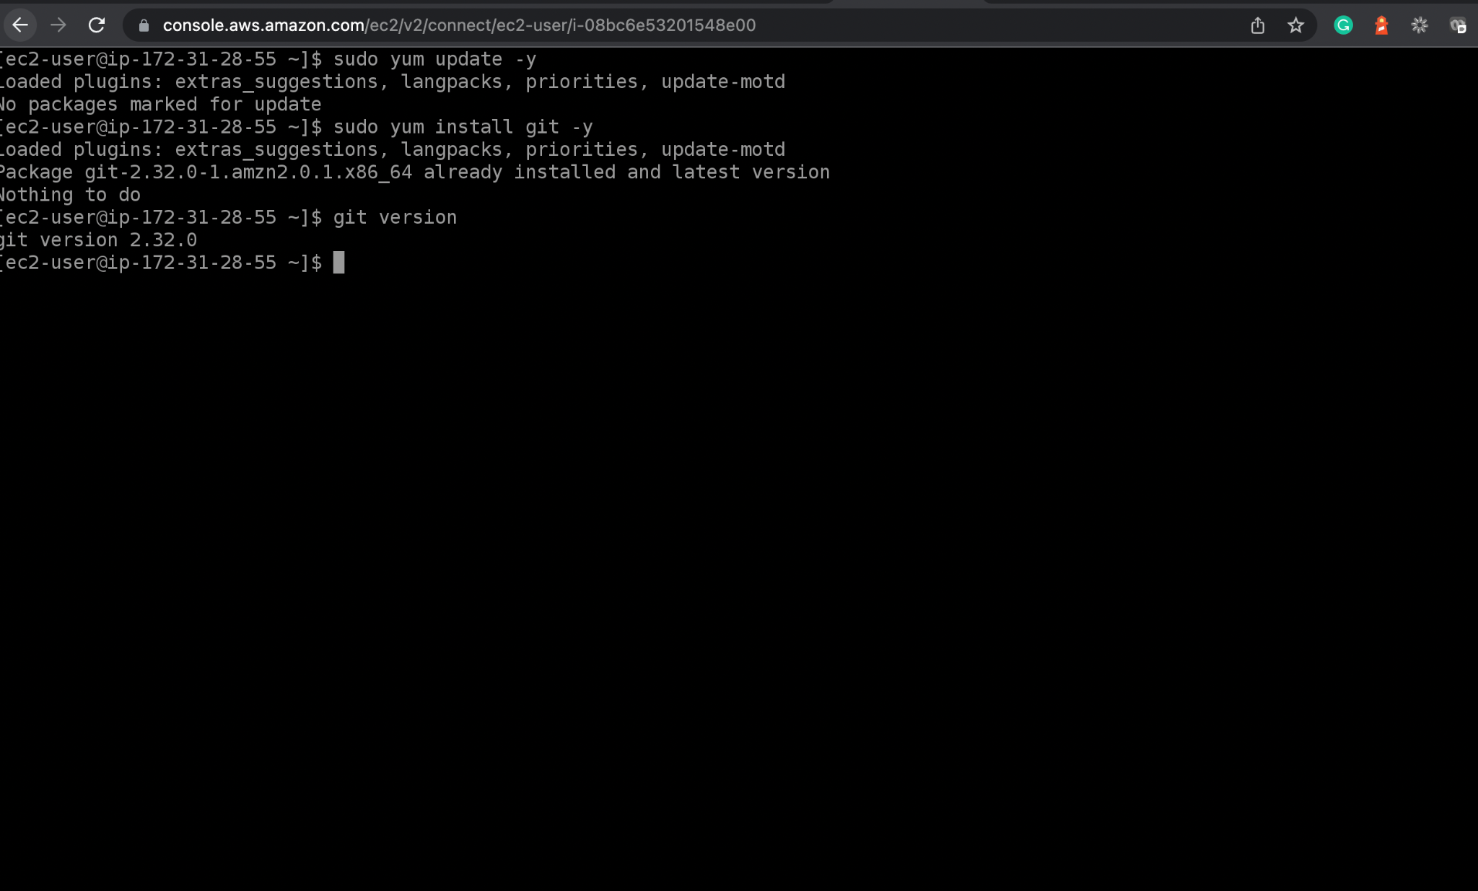
Configure Git on EC2 Instance
Configure Git.
Notes:
Configure Git.

Slide 20
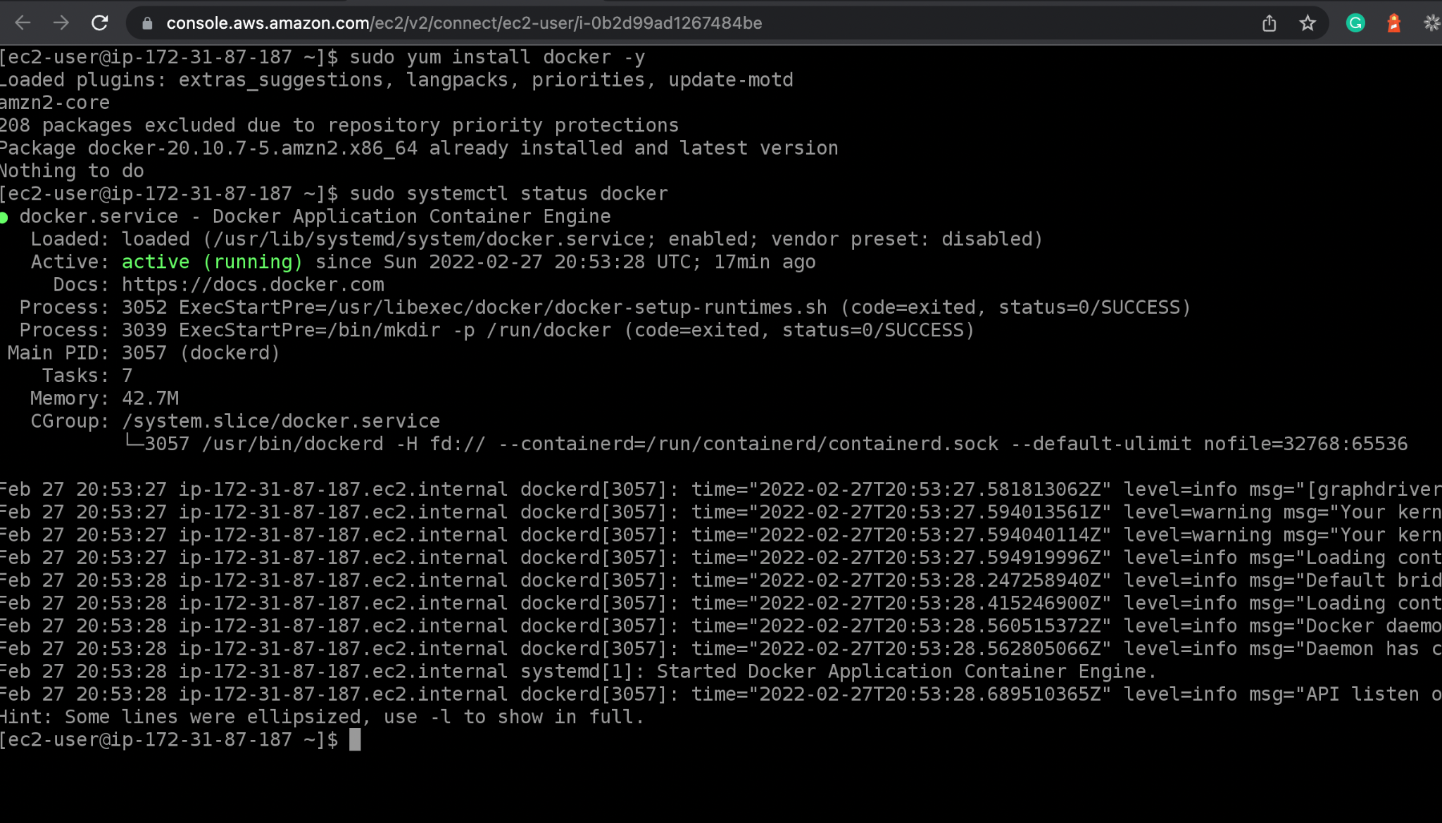
Configure Docker on EC2 Instance
Install docker for containerizing the Angular apps.
Install Docker : sudo yum install docker
Notes:
Now, let us install docker for containerizing the Angular apps.
Here are some useful commands:
Install Docker using:
sudo yum install docker

Slide 21
Configure Docker on EC2 Instance
Add ec2-user to docker group, which can execute Docker commands without using sudo and exit the terminal. Re-login to make the change effective.
Command: sudo usermod -a -G docker ec2-user
Notes:
Add the ec2-user to the docker group so you can execute Docker commands without using sudo and Exit the terminal and re-login to make the change effective
sudo usermod -a -G docker ec2-user
exit

Slide 22
Configure Docker on EC2 Instance
Enable docker service : sudo systemctl enable docker
Start docker service : sudo systemctl start docker
Check the docker service.
Notes:
Enable docker service
sudo systemctl enable docker
Start docker service
sudo systemctl start docker
Check the Docker service.
sudo systemctl status docker

Slide 23
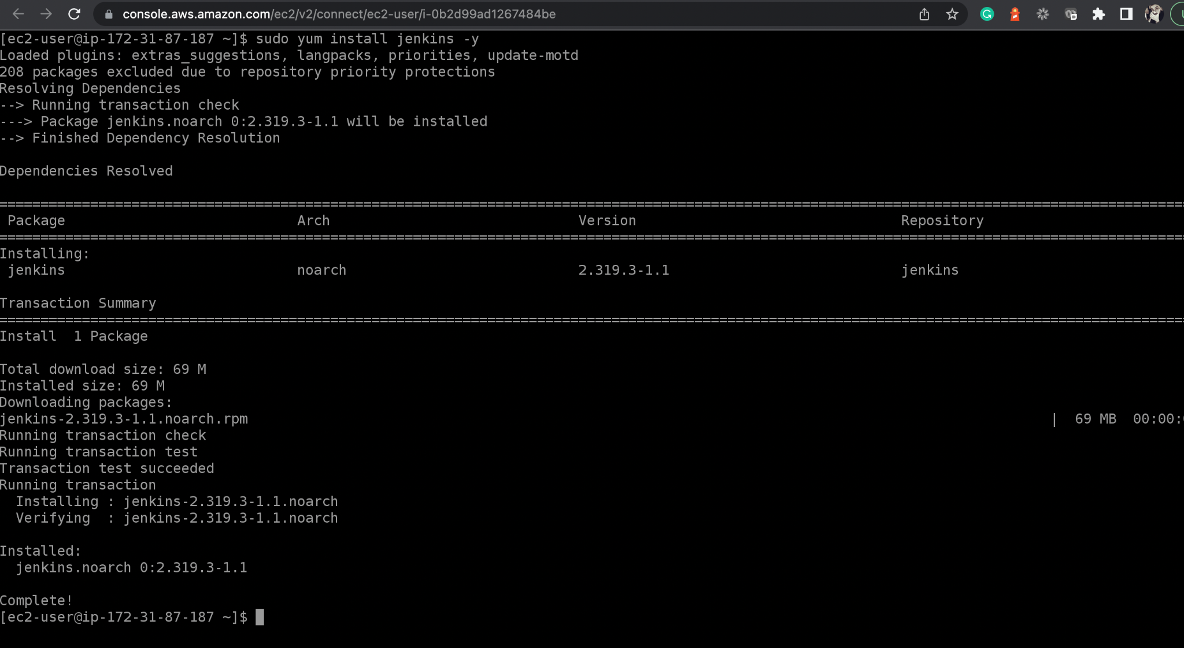
Configure Jenkins on EC2 Instance
Configure Jenkins on EC2 Instance. Install Java and use these commands.
Install JDK 8 : sudo yum update –y or sudo yum install java-1.8.0-openjdk.
Notes:
To configure Jenkins on EC2 Instance, install Java Firstly. Use these commands:
# Install JDK 8
sudo yum update -y
sudo yum install java-1.8.0-openjdk

Slide 24
Configure Jenkins on EC2 Instance
Install JDK 11 – Java : sudo amazon-linux-extras install java-openjdk11.
Install JDK 11 Development – javac : sudo yum install java-11-openjdk-devel.
Notes:
# Install JDK 11 - java
sudo amazon-linux-extras install java-openjdk11
# Install JDK 11 Development - javac
sudo yum install java-11-openjdk-devel

Slide 25
Configure Jenkins on EC2 Instance
Configure Java Version 8 or 11 : sudo alternatives --config java.
Read OS name : cat /etc/os-release
Notes:
# Configure Java Version 8 or 11
sudo alternatives --config java
# Read OS name
cat /etc/os-release

Slide 26
Configure Jenkins on EC2 Instance
Jenkins Installation document: [https://www.jenkins.io/doc/book/installing/linux/].
Follow the instructions.
sudo amazon-linux-extras install epel
sudo yum-config-manager --enable epel
sudo yum install daemonize -y
Notes:
# Open the Jenkins Installation document and follow the instructions [https://www.jenkins.io/doc/book/installing/linux/]
sudo amazon-linux-extras install epel
sudo yum-config-manager --enable epel
sudo yum install daemonize -y

Slide 27
Configure Jenkins on EC2 Instance
sudo yum install jenkins -y
sudo systemctl daemon-reload
sudo systemctl enable jenkins
sudo systemctl start jenkins
sudo systemctl status jenkins
Notes:
sudo yum install jenkins -y
sudo systemctl daemon-reload
sudo systemctl enable jenkins
sudo systemctl start jenkins
sudo systemctl status jenkins

Slide 28
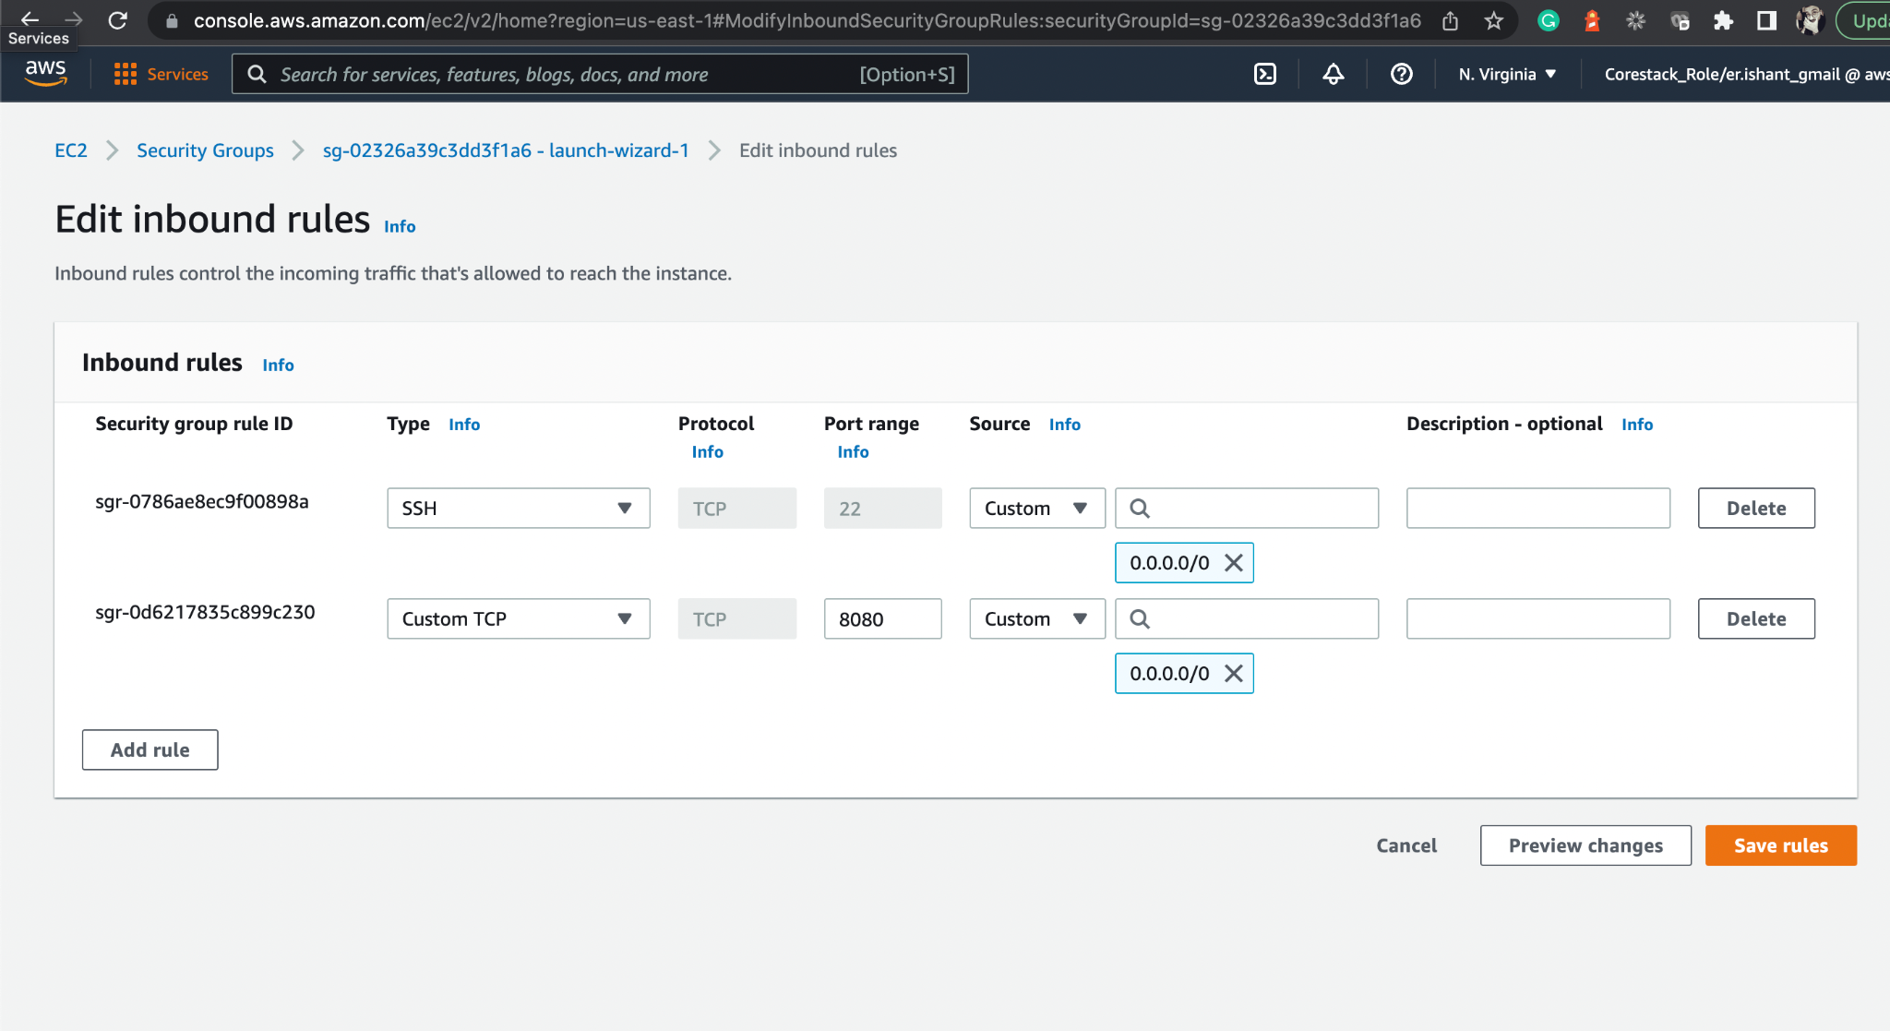
Configure Jenkins on EC2
Edit the inbound rules of security group associated with EC2 instance.
Open port 8080
so that Jenkins runs.
Notes:
Edit the Inbound rules of security group associated to EC2 instance by opening port 8080 so that Jenkins runs.

Slide 29
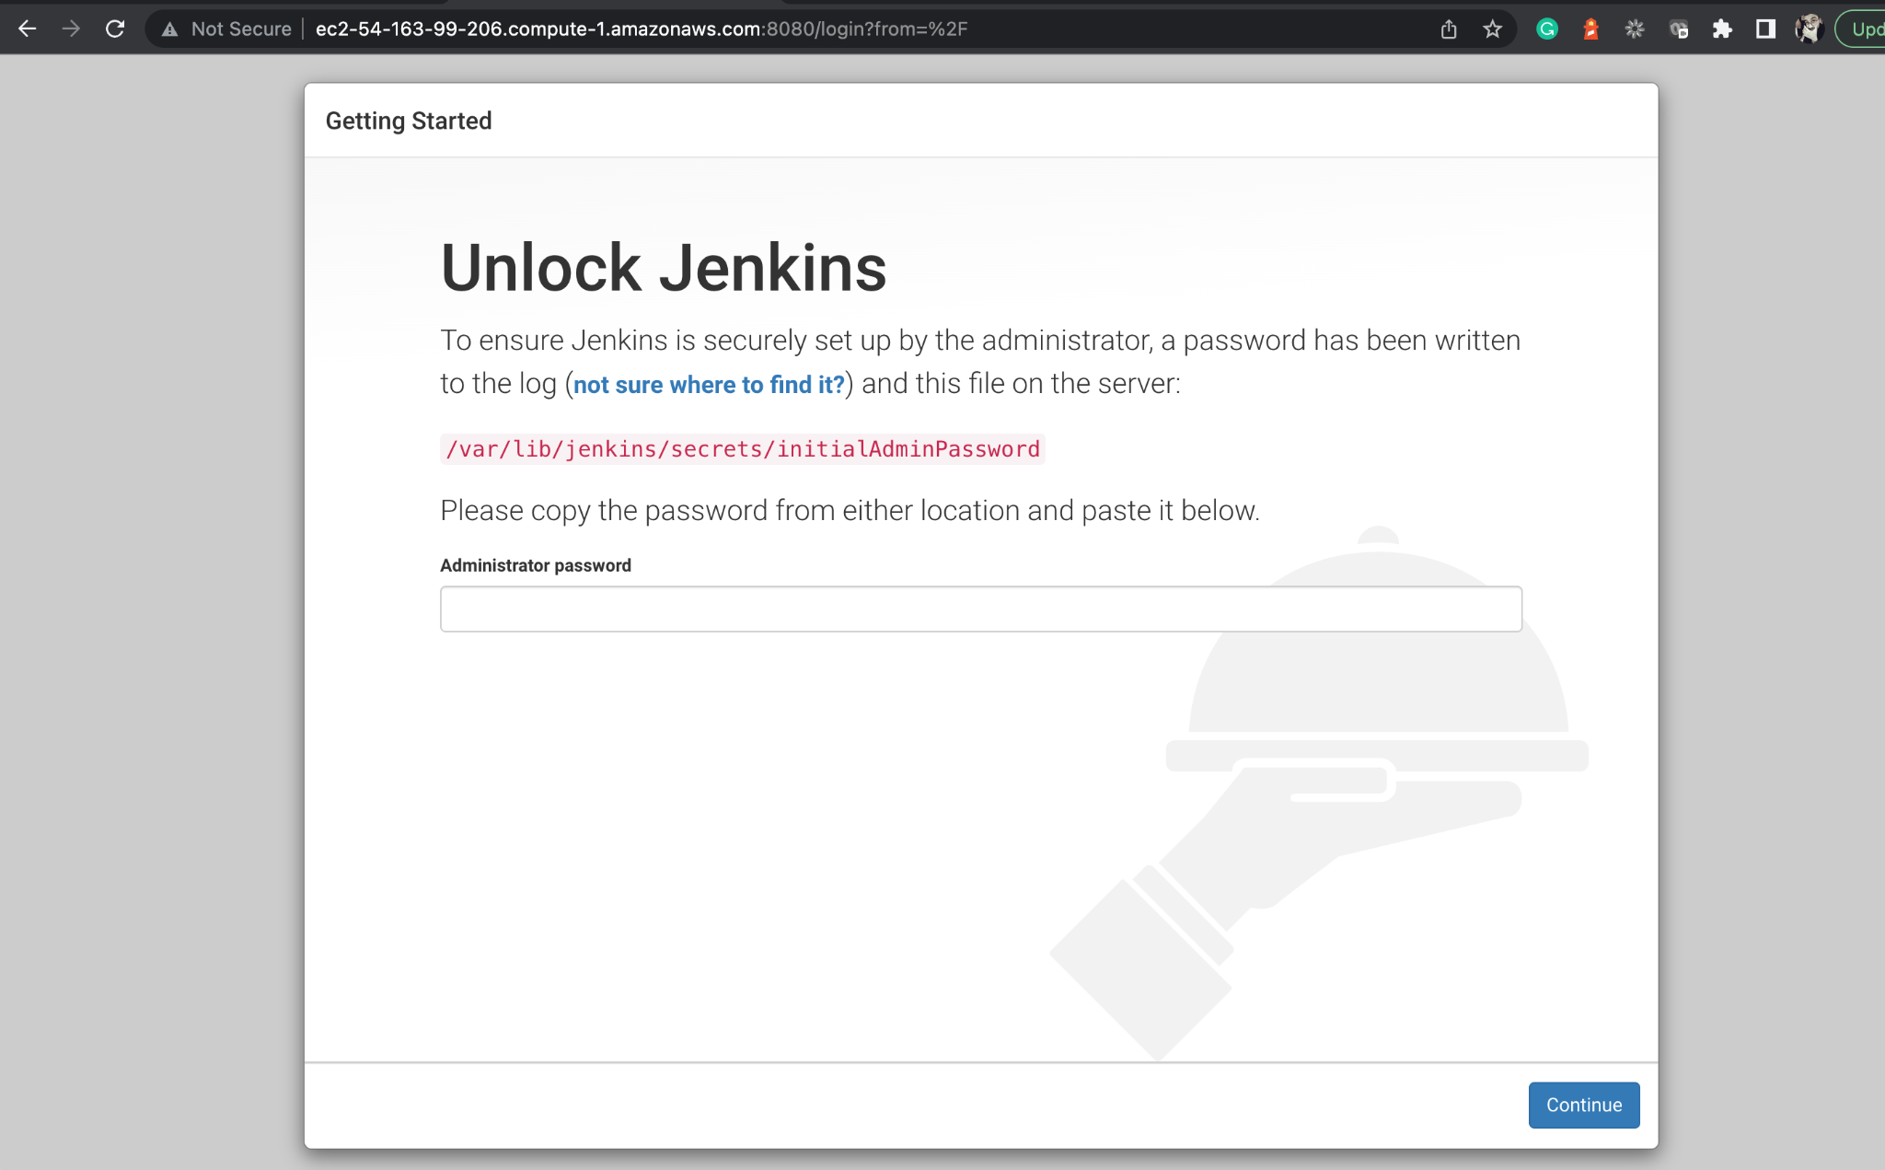
Access Jenkins on Port 8080 of EC2
From here, proceed by logging into the Jenkins with the initial password.
Notes:
From here, proceed by logging into the Jenkins with initial password.

Slide 30
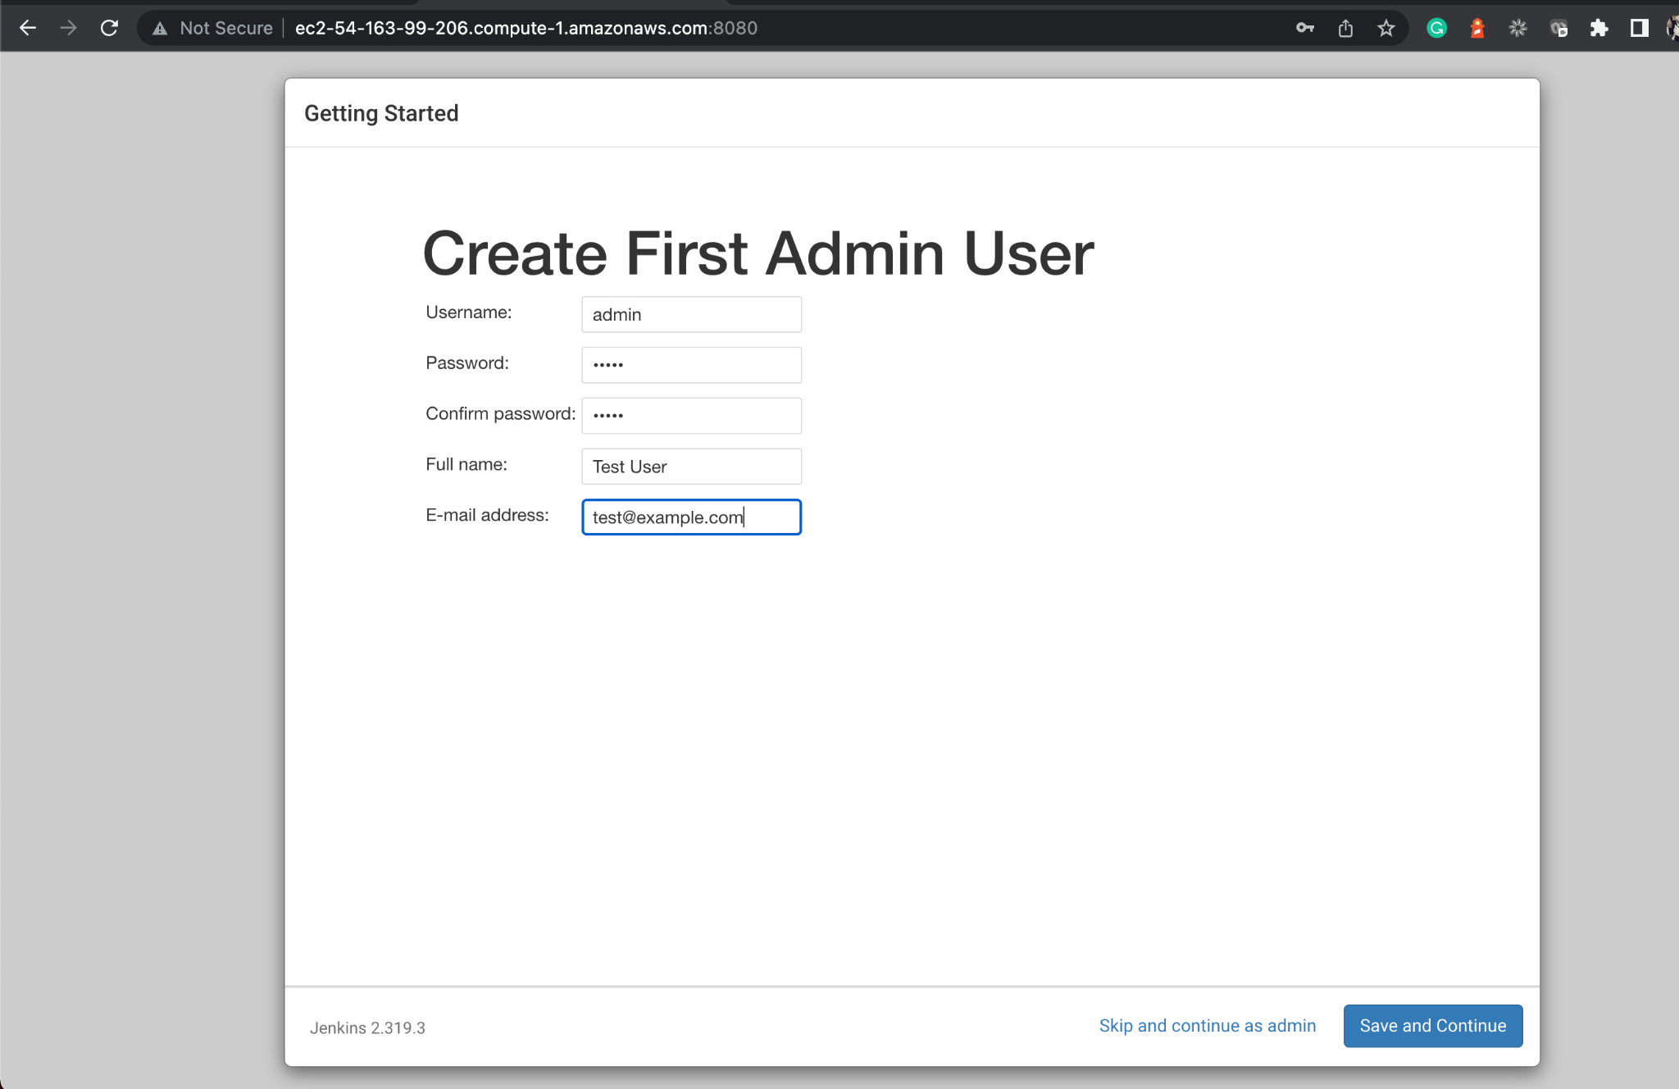
Access Jenkins on Port 8080 of EC2
Create a new user.
Notes:
Create a new user.

Slide 31
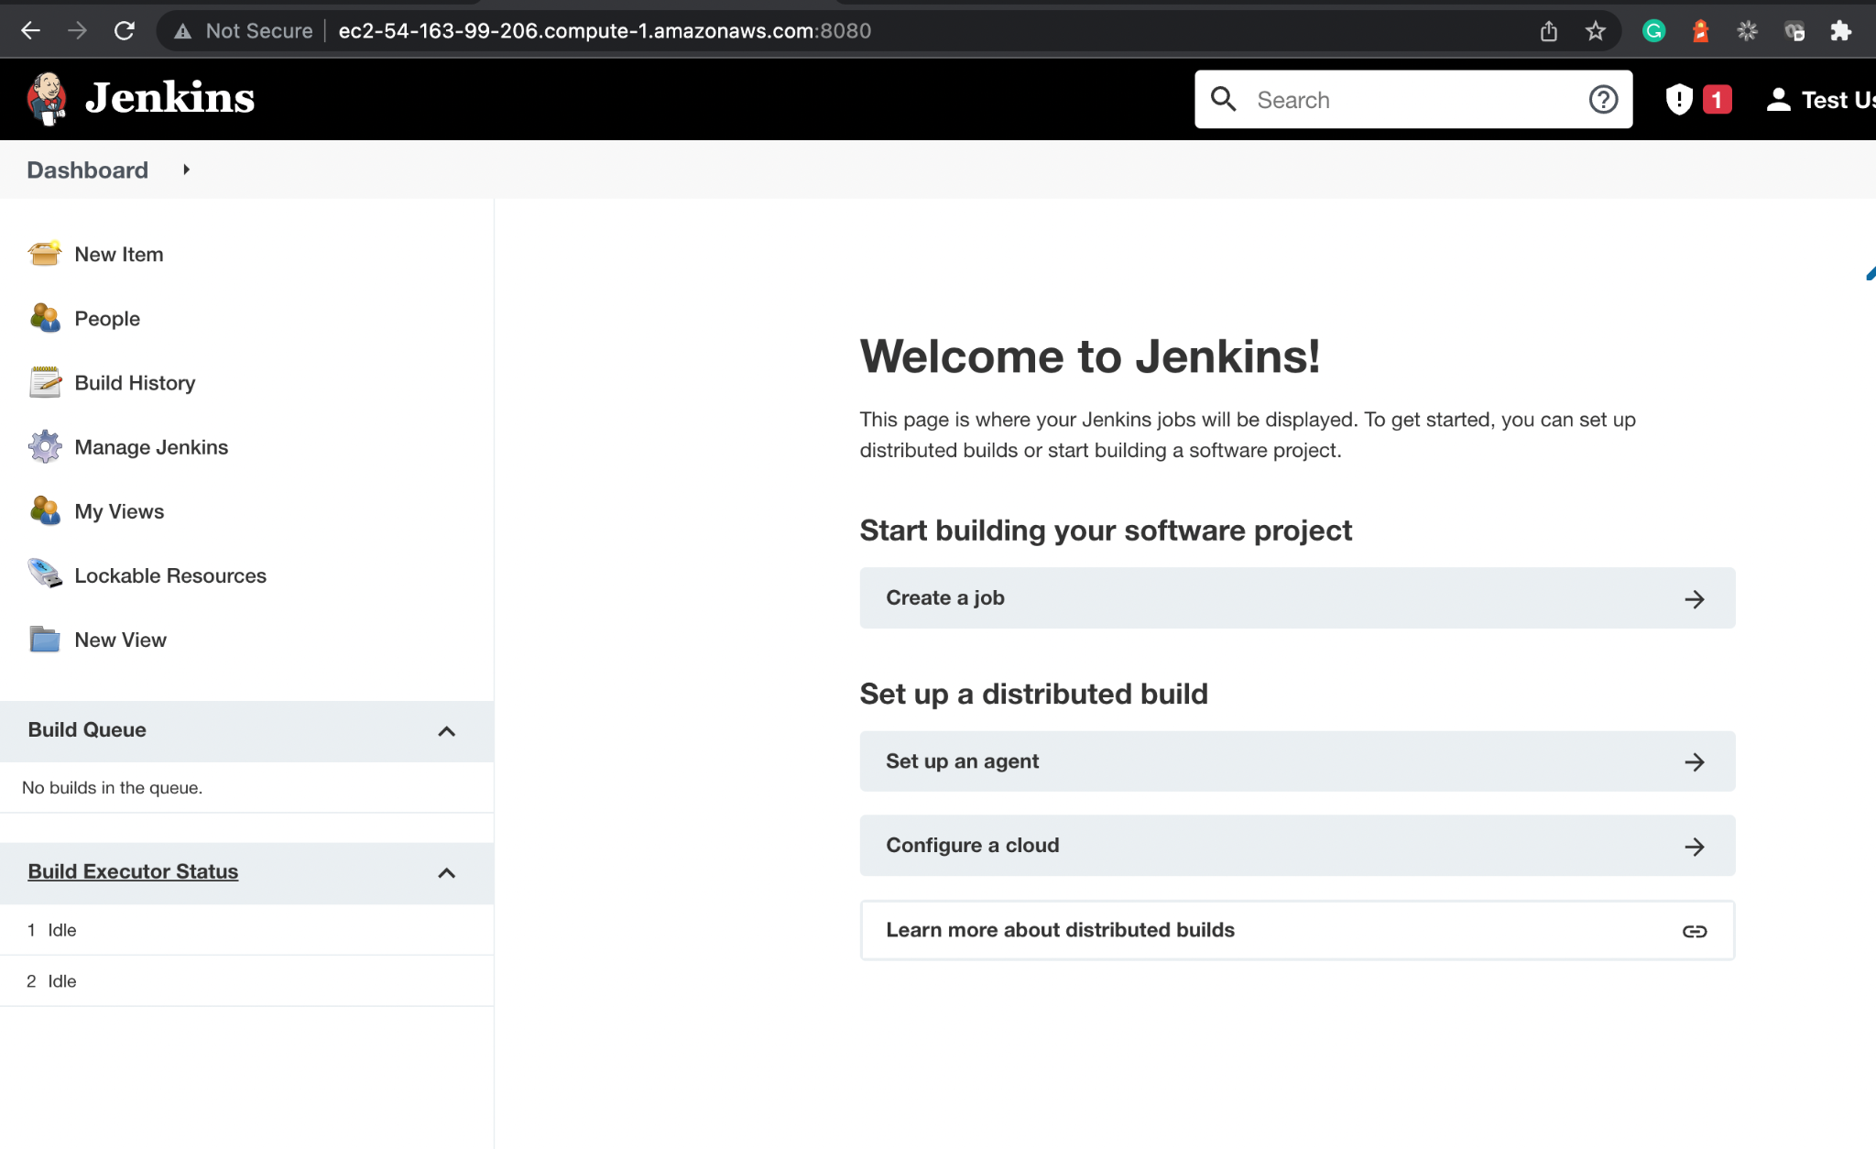
Configure Jenkins on EC2
Install desired plugins, e.g., NodeJS Plugin to be used for npm command on EC2.
Jenkins is ready to be used on EC2.
Notes:
Jenkins is ready to be used on EC2 now.
Make sure you install the desired plugins eg: NodeJS Plugin to be used for npm command on EC2.

Slide 32
Create AWS S3 Bucket
Notes:
Let us create a bucket where we can store data such as the images of products for our project.

Slide 33
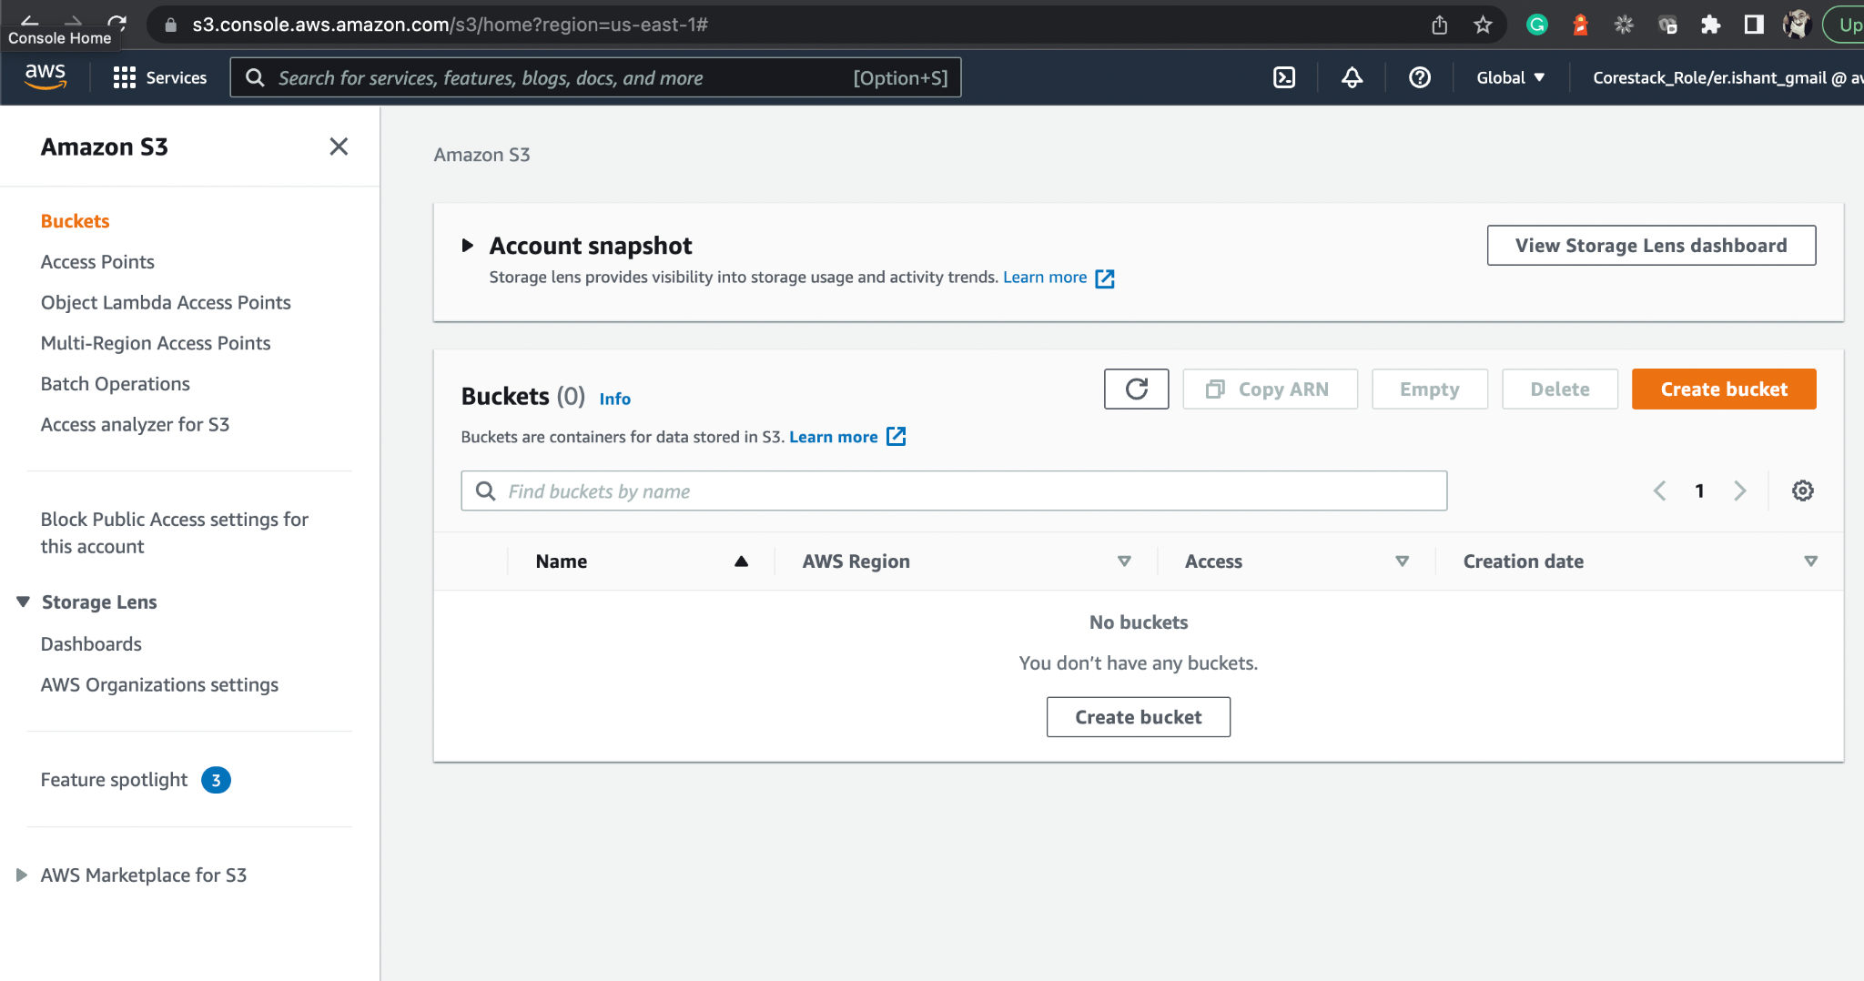
Create S3 Bucket
From the S3 dashboard, click on Create bucket.
Notes:
From the S3 dashboard, click Create bucket.

Slide 34
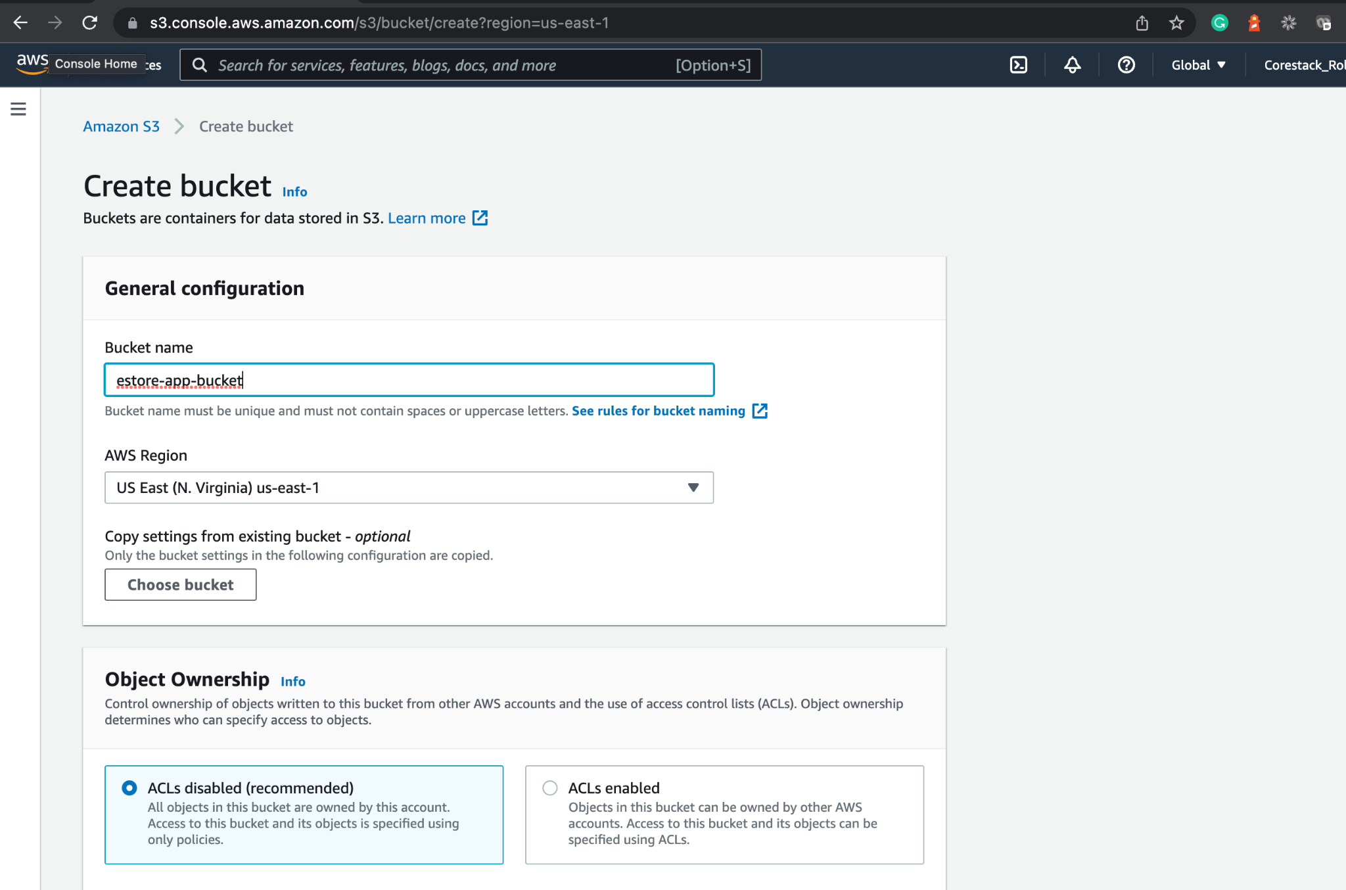
Create S3 Bucket
Make bucket accessible to public for the images to be read or written by Angular apps.
Give a name and choose
the default settings for the bucket.
Notes:
Give a name and choose the default settings for the bucket.
Make the bucket accessible to the public for the images to be read/written by angular apps.

Slide 35
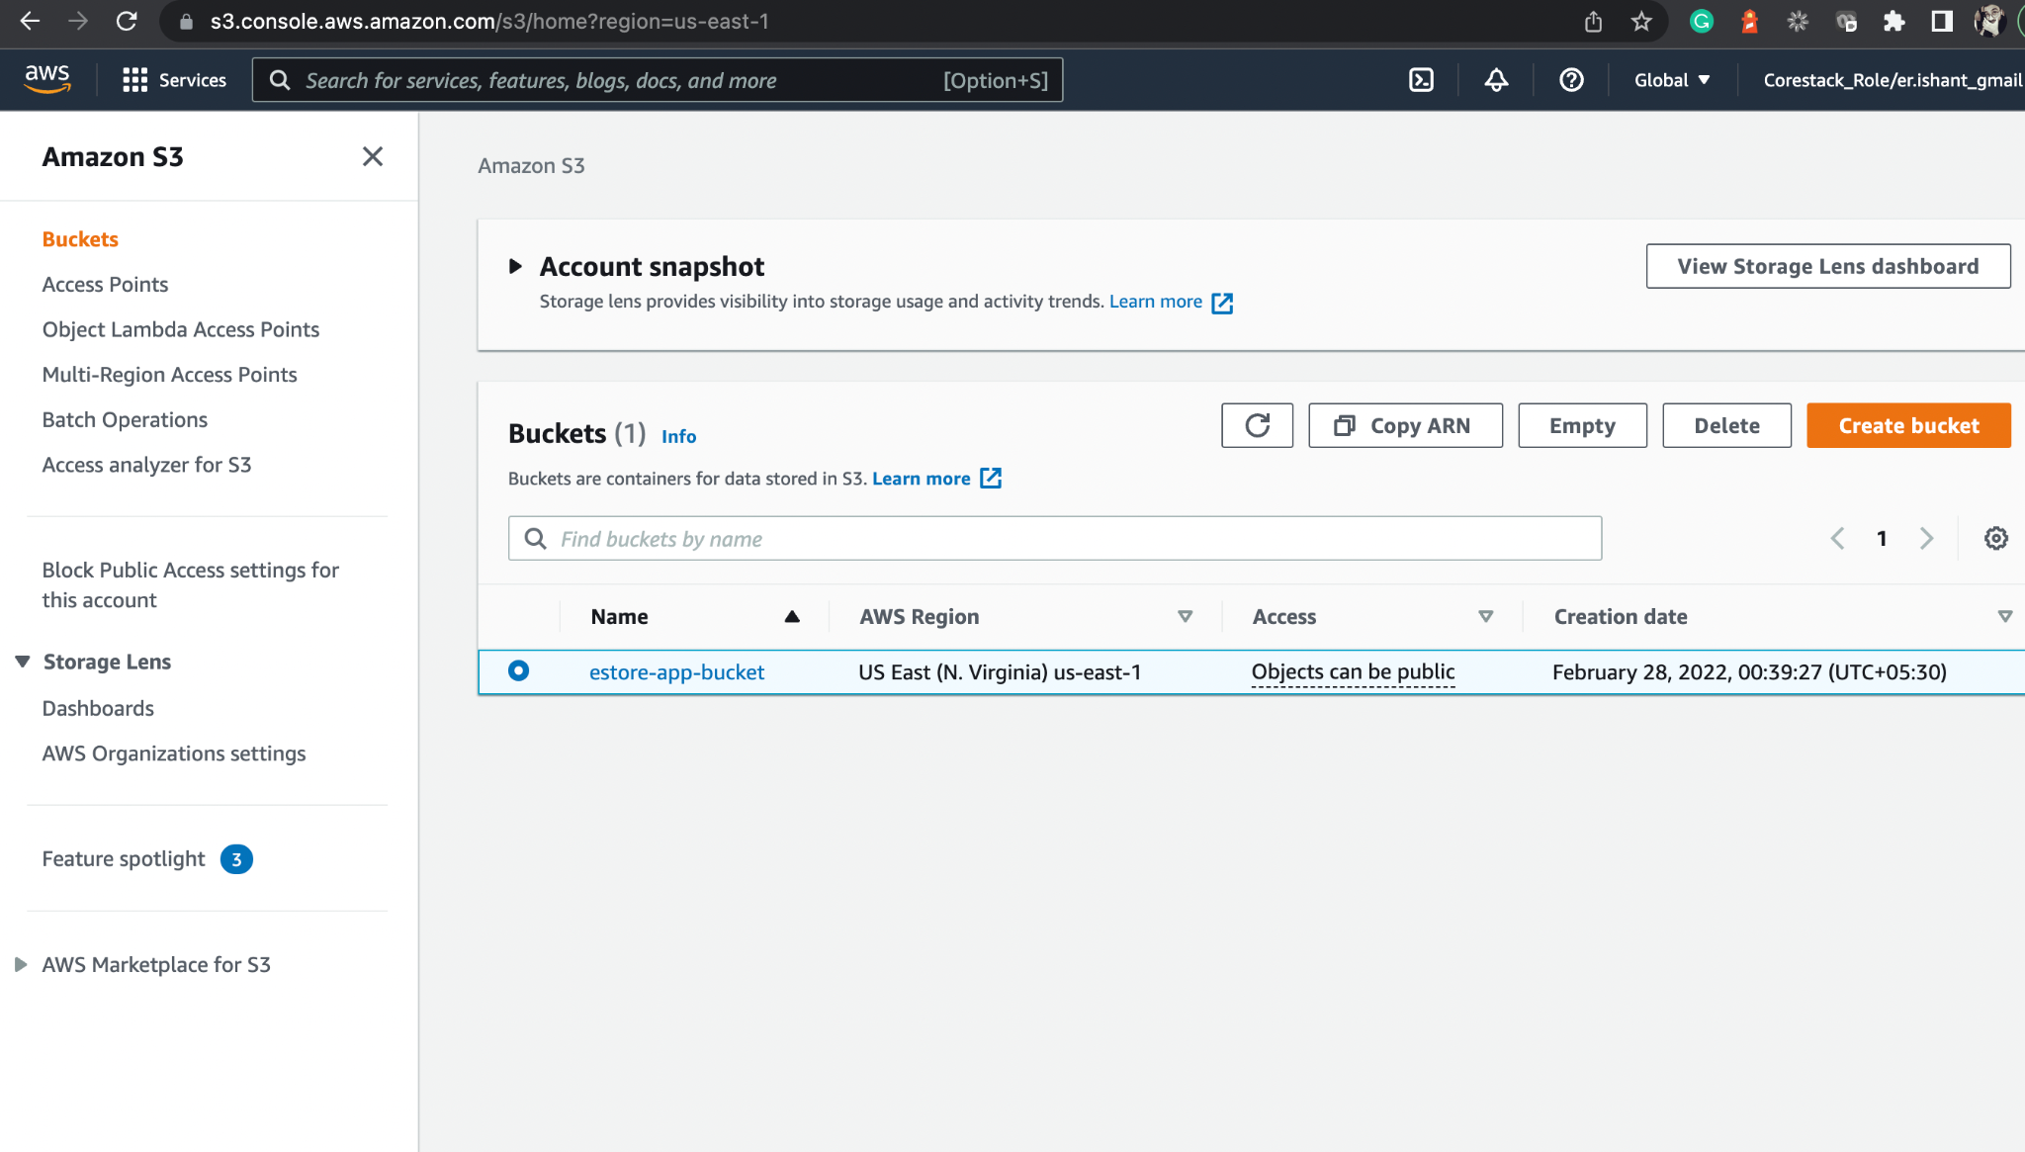
Create S3 Bucket
The bucket is configured successfully.
Notes:
We have successfully configured the bucket.

Slide 36
Build and Deploy with Jenkins Docker

Slide 37
Set Up Jenkins for the Angular Web-Admin Project
Notes:
Now, let us set up the Jenkins environment where we need to create the NodeJS Projects using Jenkinsfile for the build.
You must have Jenkins installed on your lab to create the Jenkins Pipeline Project.
Initially, we will configure for Angular web-admin project.

Slide 38
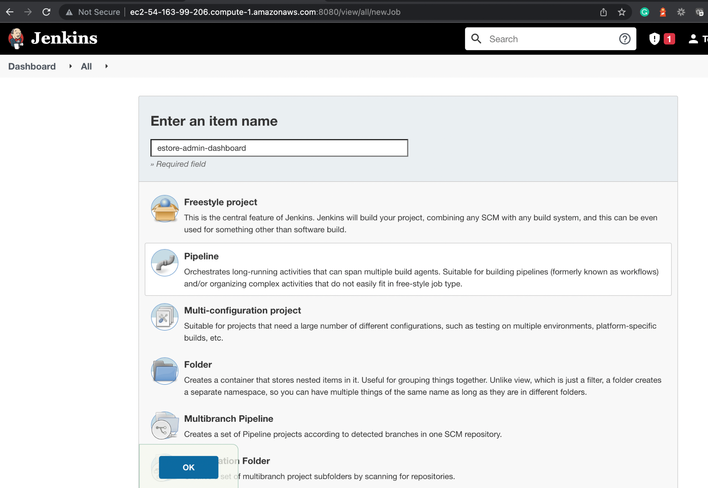
Create a Jenkins Pipeline Project for the Web-Admin Project
Create a new project in Jenkins of type Pipeline.
Notes:
Create a new project in Jenkins of type Pipeline.

Slide 39
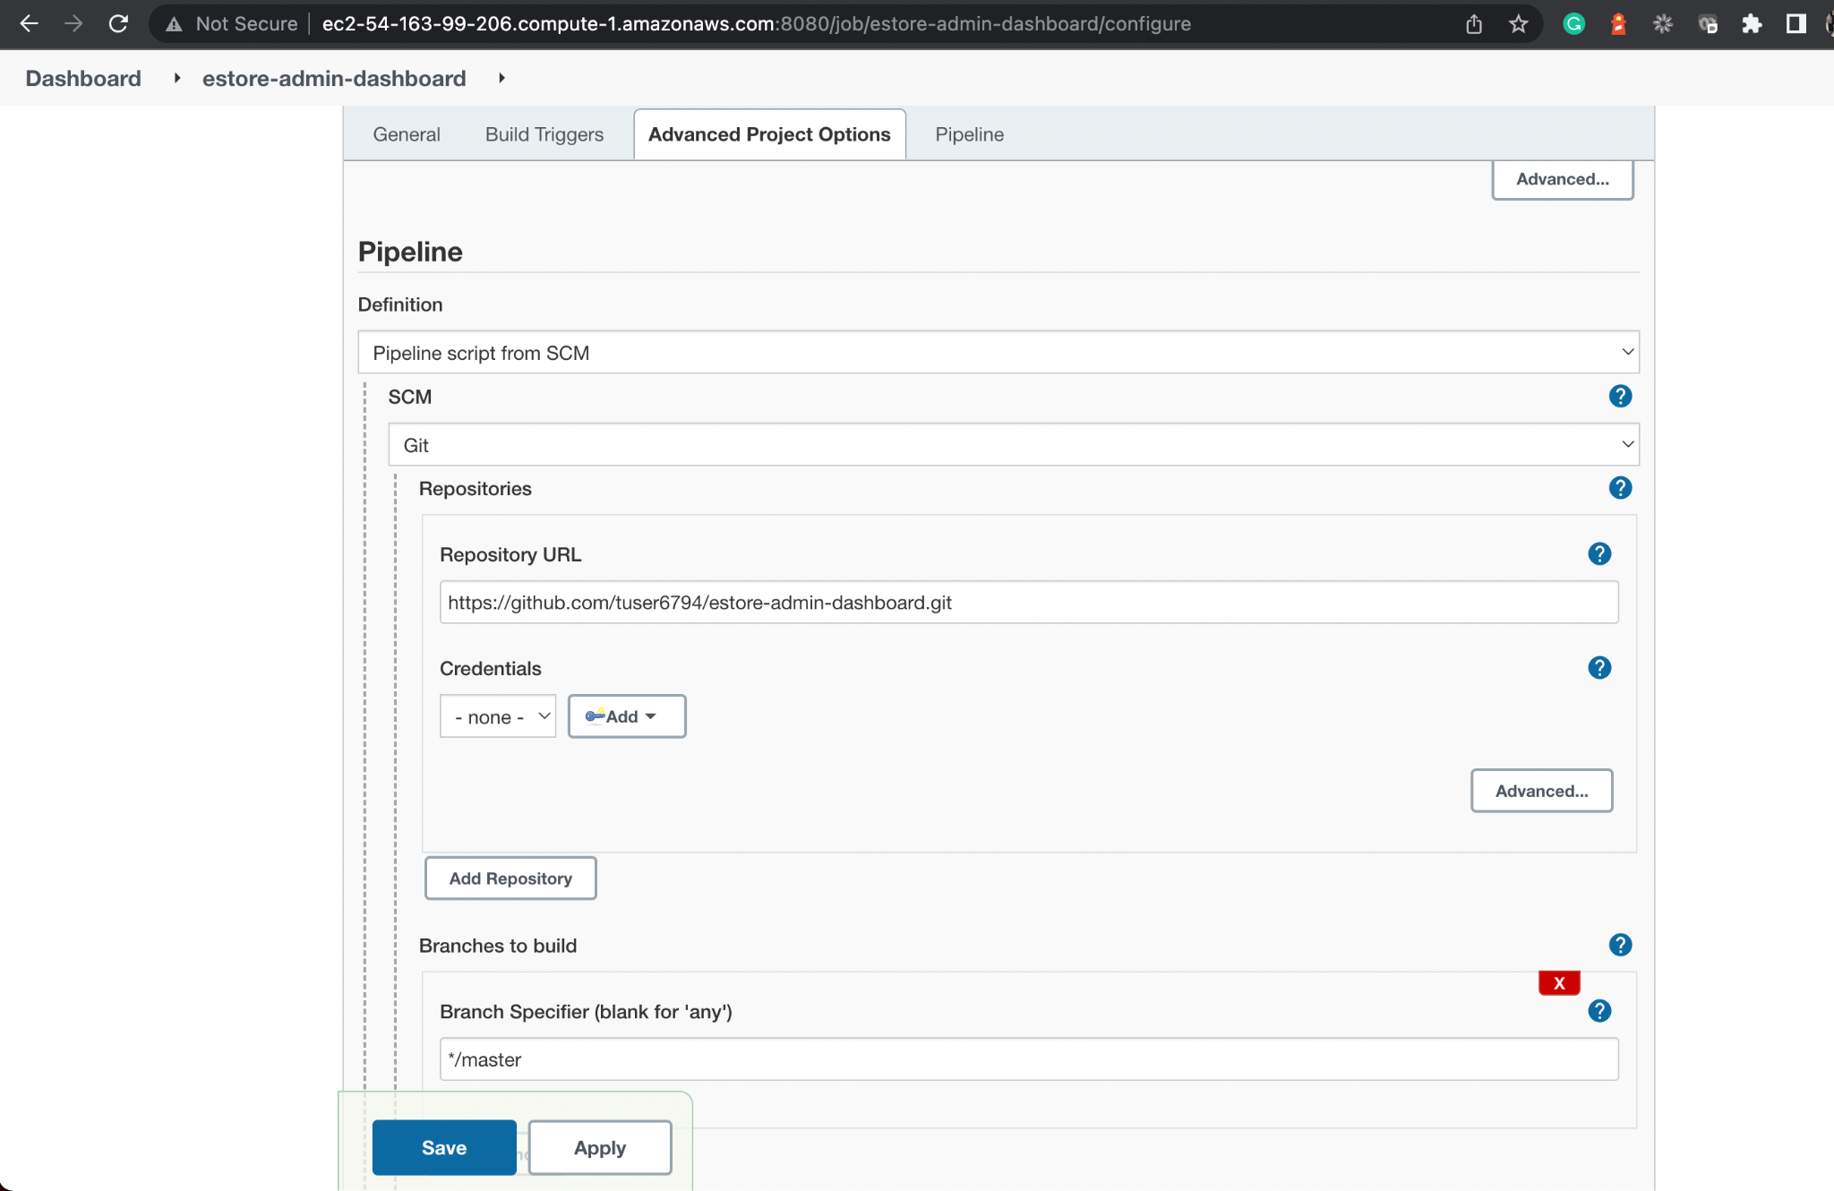
Configure Jenkins Pipeline SCM for the Web-Admin Project
Configure the Jenkins Pipeline Project by passing GitHub repository URL.
Notes:
Configure the Jenkins Pipeline Project by passing GitHub Repository URL.

Slide 40
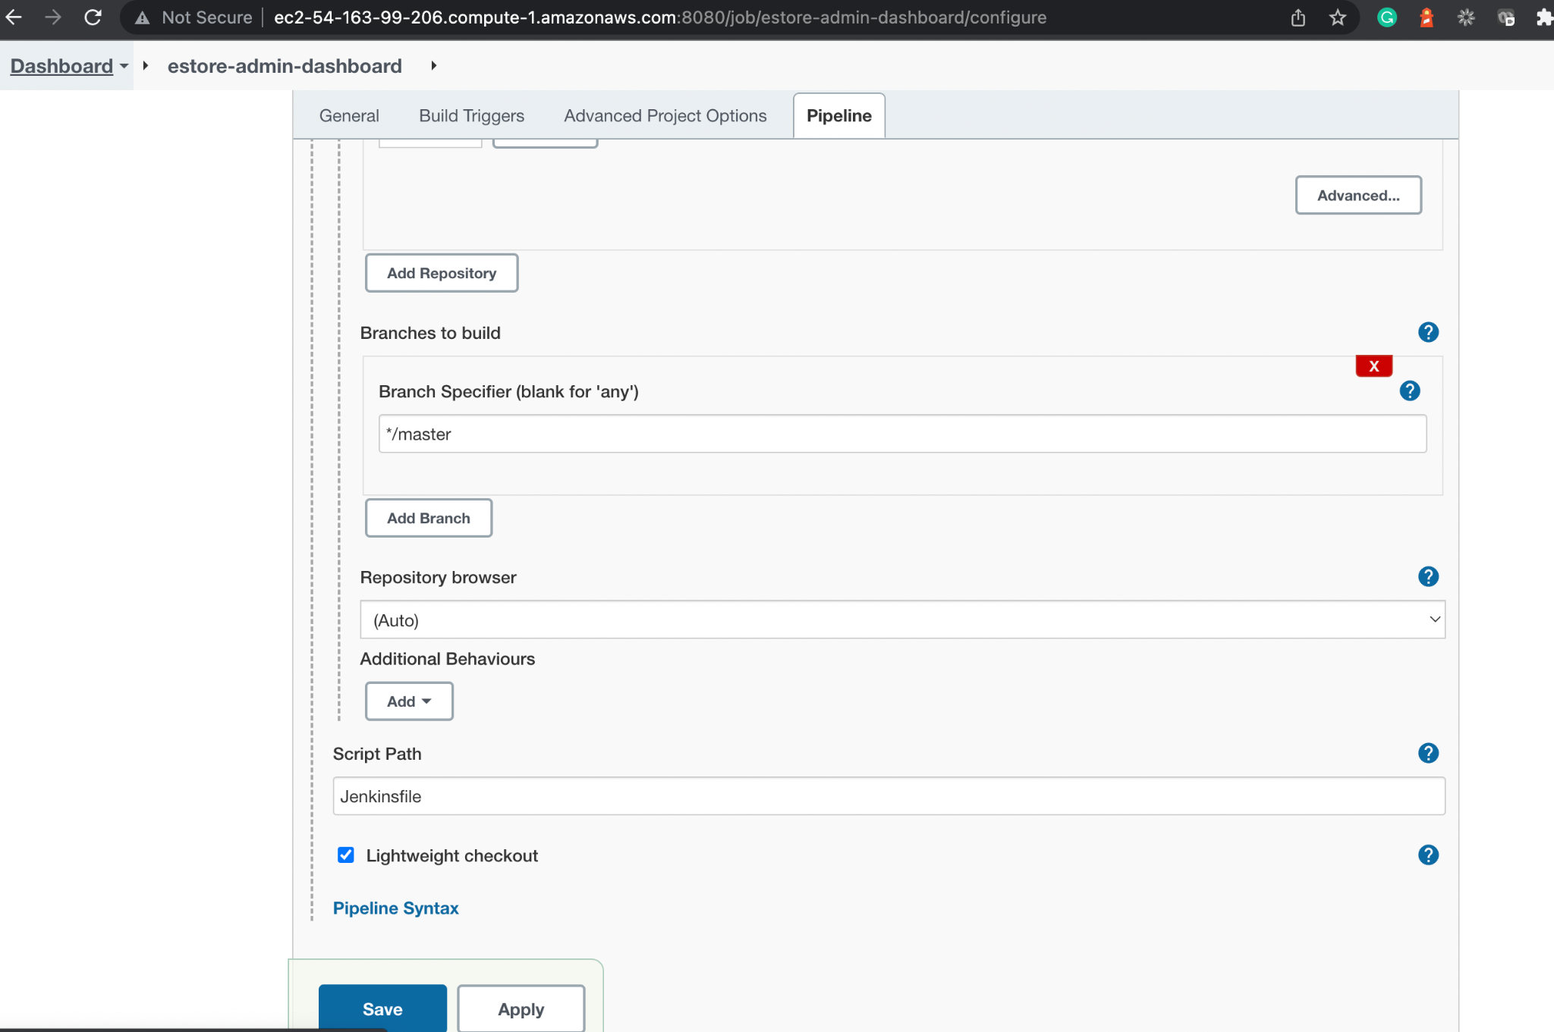
Configure Jenkinsfile in Jenkins for the Web-Admin Project
Script Path contains the Jenkinsfile, which is created in the root directory of our project.
Select the default branch, which is master.
Notes:
From the branch specifier, select the default branch which is master.
Script Path contains the Jenkinsfile, which is created in the root directory of our project.

Slide 41
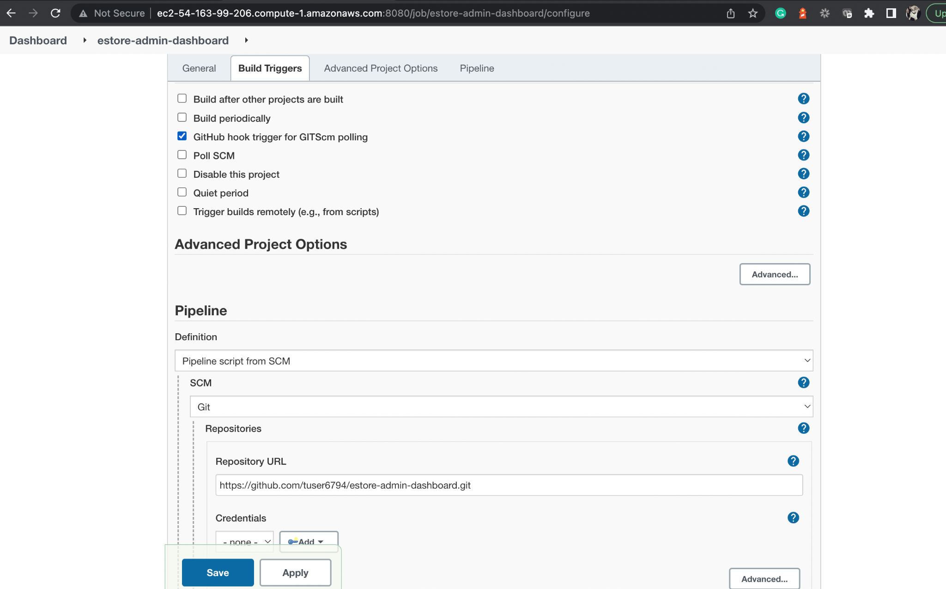
Configure GitHub Hook Trigger for the Web-Admin Project
Configure GitHub trigger for GITScm. Polling and option will work when Jenkins is running with a proper URL instead of localhost.
Configure the same using ngrok.
Notes:
This is an optional Step
Configure GitHub trigger for GITScm Polling. This option will work when Jenkins is running with a proper URL instead of localhost.
You can configure the same using ngrok.

Slide 42
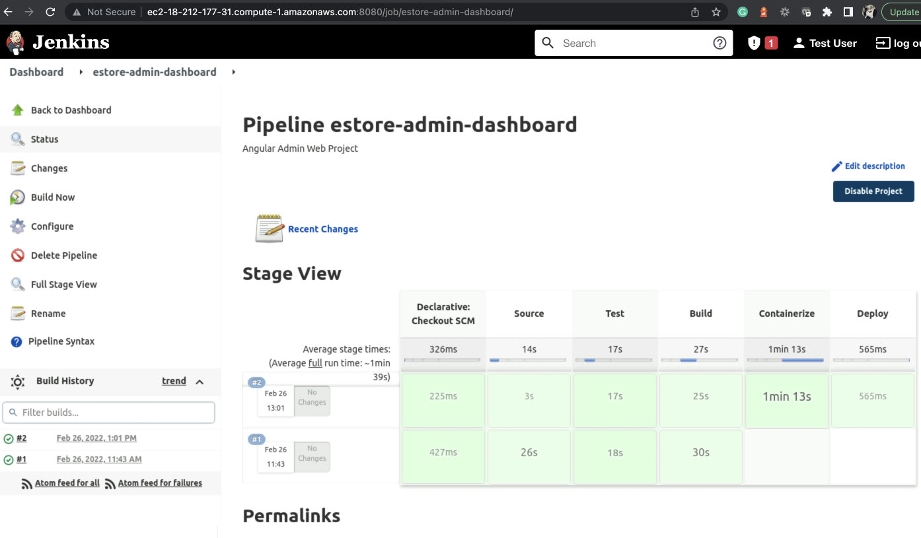
Run the Jenkins Pipeline Project for the Web-Admin Project
Notice stages appearing as mentioned in the Jenkinsfile.
Source > Test > Build > Containerize > Deploy
Click on Build Now and build project.
Notes:
Finally, click on Build Now and build your project.
You will notice the stages appearing as we mentioned in the Jenkinsfile.
Source > Test > Build > Containerize > Deploy

Slide 43
Set Up Jenkins for the Angular End-User Project
Notes:
Similarly we can set up Jenkins for the End-User Project

Slide 44
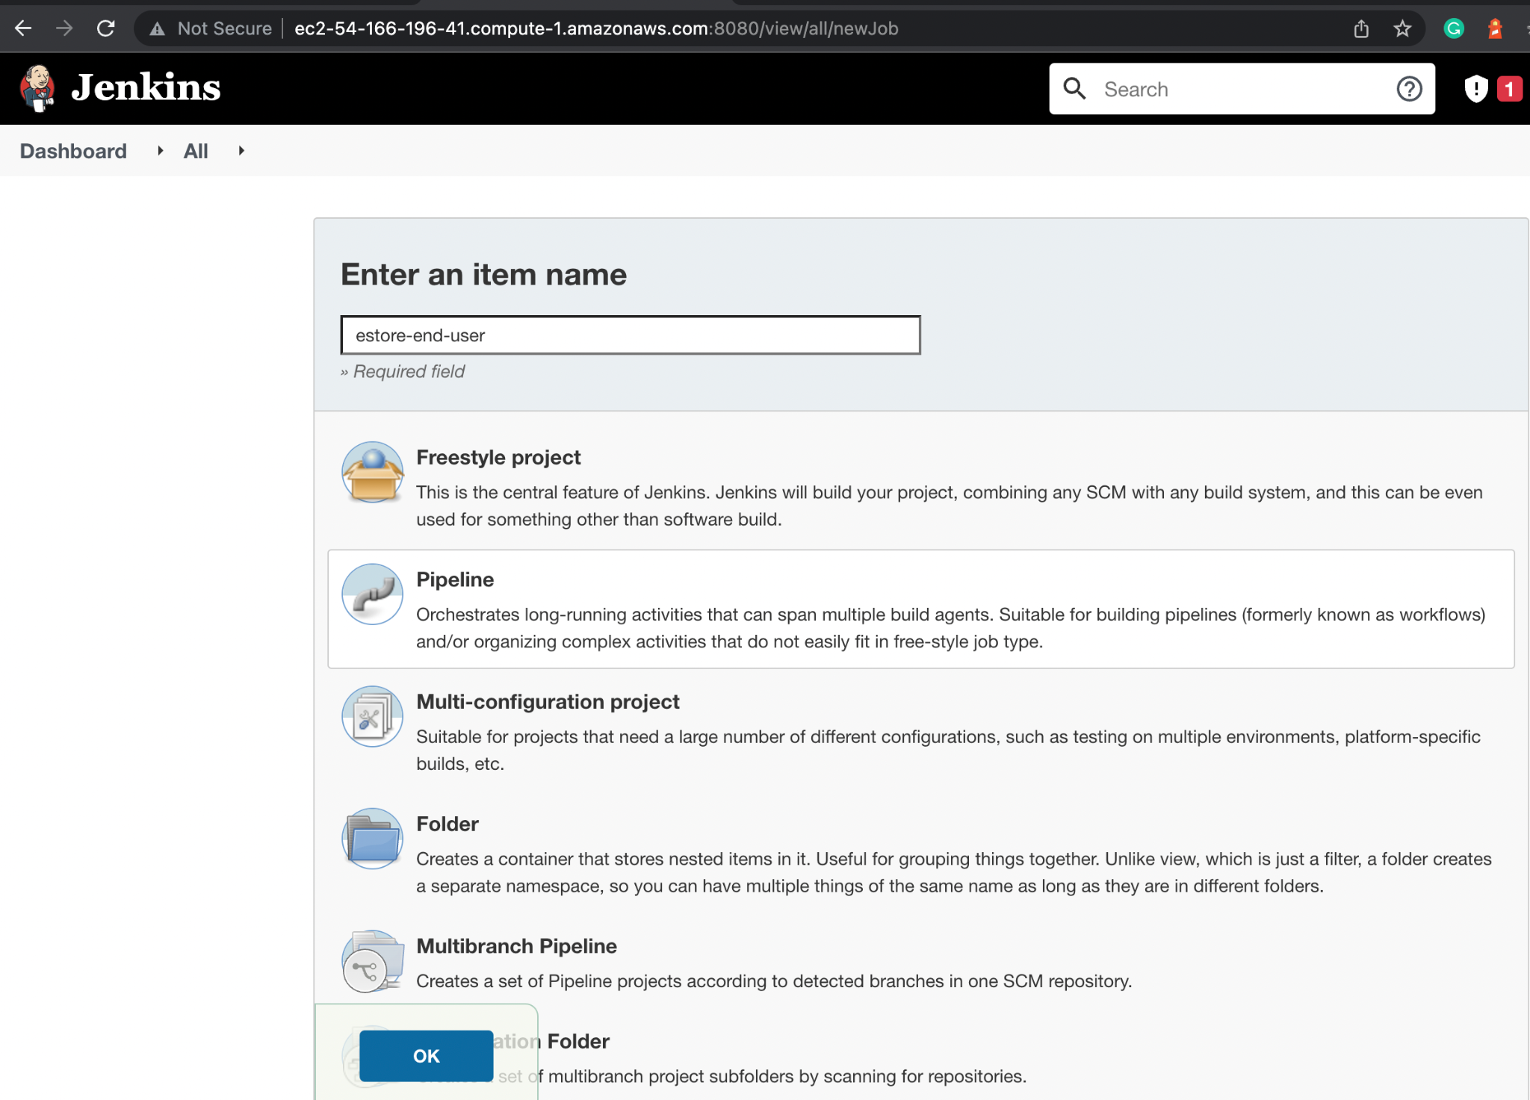
Create a Jenkins Pipeline Project for the End-User Project
Create a new project in Jenkins of type Pipeline.
Notes:
Create a new project in Jenkins of type Pipeline.

Slide 45
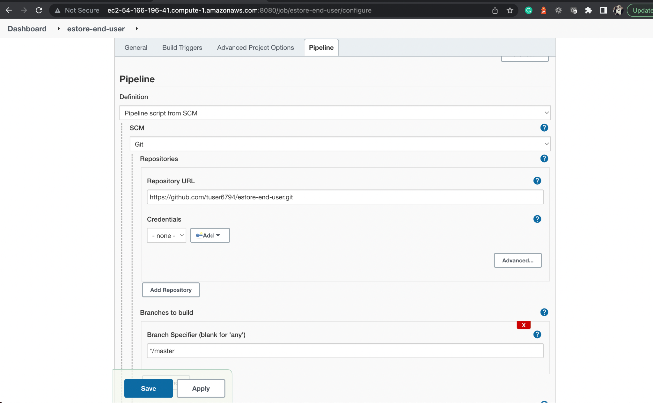
Configure Jenkins Pipeline SCM for the End-User Project
Configure the Jenkins Pipeline Project by passing GitHub repository URL.
Notes:
Configure the Jenkins Pipeline Project by passing GitHub repository URL.

Slide 46
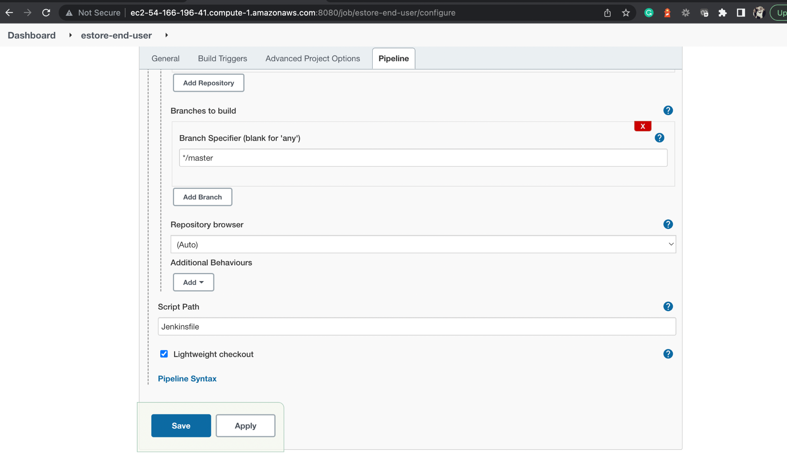
Configure Jenkinsfile in Jenkins for the End-User Project
Script Path contains the Jenkinsfile, which is created in the root directory of our project.
Select the default branch, which is master.
Notes:
From the branch specifier, select the default branch which is master.
Script Path contains the Jenkinsfile, which is created in the root directory of our project.

Slide 47
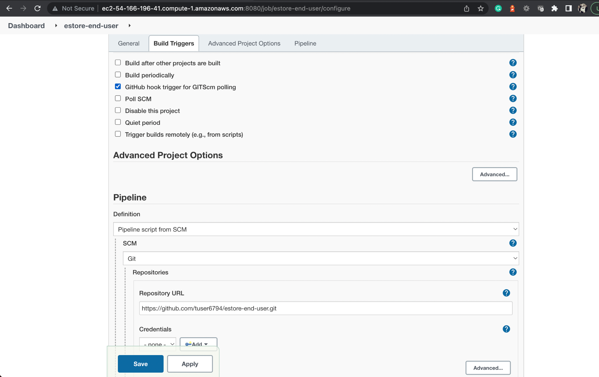
Optional: GitHub Hook Trigger for the End-User Project
Configure GitHub trigger for GITScm. Polling and option will work when Jenkins is running with a proper URL instead of localhost.
Configure the same using ngrok.
Notes:
Optional Step
Configure GitHub trigger for GITScm Polling. This option will work when Jenkins is running with a proper URL instead of localhost.
You can configure the same using ngrok.

Slide 48
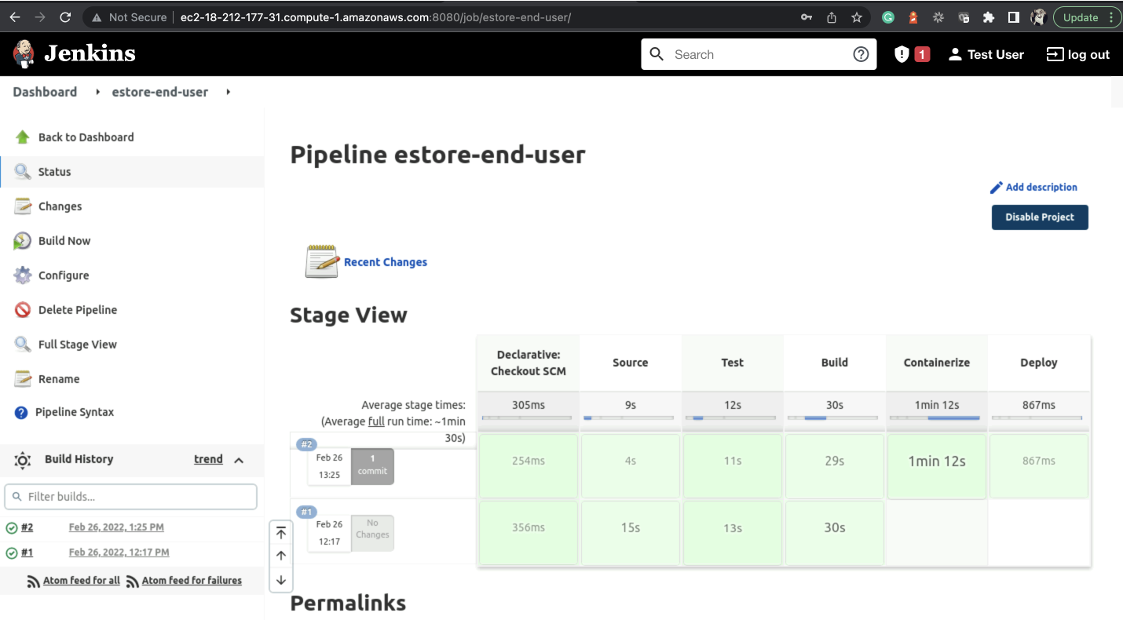
Run the Jenkins Pipeline Project for the End-User Project
Notice stages appearing as mentioned in the Jenkinsfile.
Source > Test > Build > Containerize > Deploy
Click on Build Now and build project.

Slide 49
EC2 instance is set up in AWS.
Tools and dev kits are configured on EC2 instance.
Jenkins Pipeline is built to dockerize the Angular apps.
Angular apps are made live.

Slide 51
Which package manager is used on EC2 to install tools?
01
YUM
npm
pip
brew

Slide 52
Which package manager is used on EC2 to install tools?
01
YUM
npm
pip
brew
A
YUM is the primary package management tool for installing, updating, removing, and managing software packages in
Red Hat Enterprise Linux.

Slide 53
What is the default username for EC2 instance for connections?
02
ec2user
ec2-user
root
admin

Slide 54
What is the default username for EC2 instance for connections?
02
ec2user
ec2-user
root
admin
B
You can connect to EC2 instance with your private key pair with the username as ec2-user.

Slide 55
How can you access Jenkins on port 8080 of your EC2 instance?
03
Directly
By creating an outbound rule for port 8080
By creating an inbound rule for port 8080
None of the above

Slide 56
How can you access Jenkins on port 8080 of your EC2 instance?
03
Directly
By creating an outbound rule for port 8080
By creating an inbound rule for port 8080
None of the above
C
You must edit the security group for an inbound rule to be created for port 8080 with the IP as anywhere.

Slide 57
What is the default script path when you choose Git option for the Jenkins Pipeline project?
04
Master
Dockerfile
Jenkinsfile
None

Slide 58
What is the default script path when you choose Git option for the Jenkins Pipeline project?
04
Master
Dockerfile
Jenkinsfile
None
C
By default, the script path will be Jenkinsfile, which should be in your root directory of the project.

Slide 59
What is the need for S3 Bucket in the project?
05
To store user details
To store logs
For Jenkins build
For product images

Slide 60
What is the need for an S3 Bucket in the project?
05
To store user details
To store logs
For Jenkins build
For product images
D
We will create an S3 bucket to store product images for our project with public access.

Slide 61
Before the Next Class
You have successfully completed this session.
For our next end user module discussion, you should:
Review AWS services
Explore steps to create EC2 and S3 buckets
Explore how to connect to EC2 instance
Review Jenkins
Review Docker commands

Slide 62
What’s Next?
Now we have finished our classes and design Pattern for the back-end project with respect to end-user module.
In our next live session, we will:
See how to create EC2 Instance on AWS
See how to work with RDS MySQL
Deploy Java back end on EC2
Use Jenkins and Docker as DevOps tools on EC2

